Slide 1
THE CHAMBER OF ACCOUNTS (AZERBAIJAN REPUBLIC)
KEY NATIONAL INDICATORS:
THE ROLE OF SUPREME AUDIT INSTITUTIONS
ZAUR VALIYEV

Slide 2
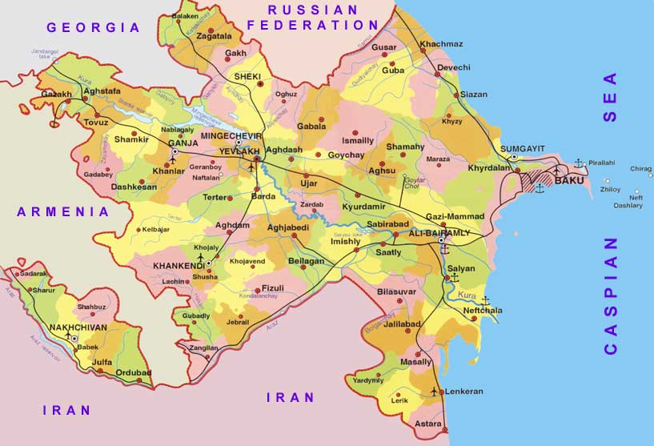

Slide 3
Conclusion
The Key National Indicators
The Budget Execution Report &
The report about render opinion on State Budget Law
Fiscal diagnostic tools: PEFA & OBI

Slide 4
ANALYZE THE KNI ON
BUDGET EXECUTION REPORT &
THE REPORT ABOUT RENDER OPINION ON STATE BUDGET LAW

Slide 5
The Budget Execution Report
The report about render opinion on State Budget Law

Slide 6
WORLD ECONOMY
Political & economical risks
Real sector:
Economic growth rate by country, oil price volatility and etc.
Fiscal sector:
Debt sustainability problems in EU countries & other region, and etc.
Monetary sector:
Monetary policy in selected countries

Slide 7
MACRO-FISCAL RISKS
EXTERNAL
IMPORT-EXPORT
MONETARY
Exchange rate, Strategic currency reserves
FISCAL
Consolidated and state budget indicators,
Fiscal Sustainability
REAL
GDP by Expenditure, per capita,
Oil price, CPI (inflation), Investment

Slide 8
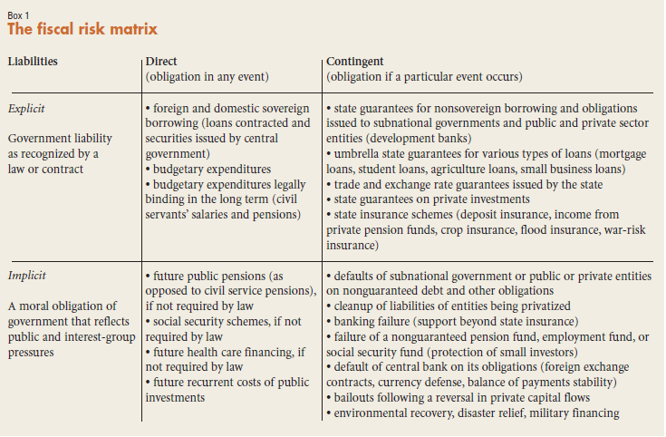
MACRO-FISCAL RISKS (ISSAI 5430)

Slide 9
DEFINING MACRO-FISCAL RISKS (IMF)
Fiscal risks are factors that may cause fiscal outcomes to differ from expectations…
General economic risks
*related to general economic forecast parameters
*Examples: domestic demand shock; trade volume shock; commodity price shock
Specific fiscal risks
* Difficult to isolate using general economic forecast parameters
* Give rise or contribute to uncertainty about specific fiscal outcomes
Institutional risks
* Constrain the effectiveness of fiscal risk management
* Examples: lack of expenditure control; poor cash management; poor revenue collection
Other specific risks
* Arise from changing conditions linked to a specific source
* Examples: change in asset and liability values; tax avoidance; demographic change
Contingent liabilities
* Arise from the occurrence of a specific event
Implicit
* Based on expectation or pressure to provide support
* Examples: failing PPP; bailouts of SOEs, banks, and sub-national government; natural disasters
Explicit
* Based on a firm legal obligation or declared policy
* Examples: government guarantees; PPP related min. guarantees; deposit insurance; legal claims.

Slide 10
REAL SECTOR
GDP BY EXPENDITURES
System of National Accounts (SNA)
Government Finance Statistics (GFS)
GDP BY PRODUCTION METHOD
industry, agriculture, service sectors and etc.
OTHER MACROECONOMIC ISSUES
GDP per capita, CPI (inflation), investment, and etc.

Slide 11
PUBLIC FINANCIAL MANAGEMENT
Fiscal sustainability
Fiscal discipline
Fiscal institutions:
Fiscal rules: numerical (debt, golden rule) & procedural
Fiscal Law (Budget System Law)
Fiscal Council (Independency Fiscal Agency)
Main objectives: Macroeconomic stabilization, Allocation of resources & Income distribution
a)Resource-Rich Countries
b)Debt sustainability
c)Pension system sustainability
d)Tax system sustainability
e)Budget system sustainability
Fiscal risks
1.Rising debt & deficit
2.Oil price volatility
3.Old age dependency ratio
4.Tax burden & tax expenditures
5.Intergovernmental fiscal transfers

Slide 12
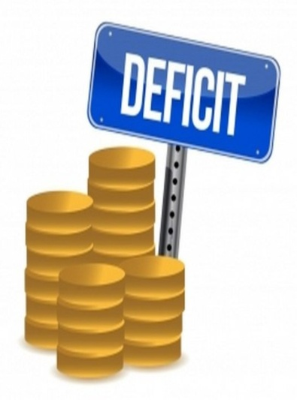
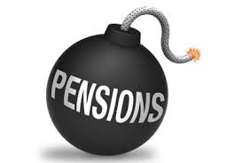
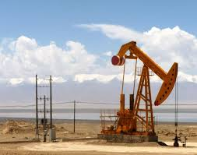
FISCAL SUSTAINABILITY
DEBT SUSTAINABILITY
FISCAL SUSTAINABILITY FOR RESOURCE-RICH COUNTRIES
BUDGET SYSTEM SUSTAINABILITY
TAX SYSTEM SUSTAINABILITY
PENSION SYSTEM SUSTAINABILITY

Slide 13
 | 2013 | 2014 | 2015 | 2016 | 2017 | 2018
1. STRATEGIC CURRENCY RESERVES TO GDP | 66,1 | 67,6 | 72,9 | 98,3 | 100,9 | 90,4
Criteria
2. STRATEGIC CURRENCY RESERVES TO IMPORT | 30,2 | 31,0 | 26,0 | 28,0 | 30,0 | 46,8
Criteria: minimum 3 month
3.FISCAL POSITION OF GOVERNMENT | 53,5 | 56,4 | 51,5 | 78,0 | 76,4 | 67,3
Criteria: positive result
4.PUBLIC DEBT RATIO TO GDP | 12,6 | 11,2 | 28,3 | 22,3 | 24,2 | 23,1
Criteria: 60% but for LIC 30-40%
5.DOMESTIC DEBT TO GDP | 4,5 | 2,6 | 8,5 | 2,0 | 1,5 | 1,2
Criteria: not more 20-30%
6. INTEREST PAYMENTS TO EXPORT | 3,9 | 2,2 | 6,0 | 12,1 | 6,4 | 7,1
Criteria: 15% (low), 20% (medium), 25% (high)
7. INTEREST PAYMENTS TO BUDGET REVENUES | 3,7 | 2,1 | 4,0 | 10,1 | 9,2 | 9,2
Criteria: 25% (low), 30% (medium), 35% (high)
8. BUDGET DEFICIT TO GDP | 0,6 | -0,5 | -0,5 | -0,4 | -1,8 | -0,1
Criteria: not more 3%
 | 2015 | 2016 | 2017 | 2018
Oil revenues share state budget revenues, mln.manat (national currency) | 10220,0 | 9225,0 | 7884,0 | 13346,0
SOFAZ (Azerbaijan Oil Fund) transfer | 8130,0 | 7615,0 | 6100,0 | 10996,0
SOCAR (Azerbaijan Oil Company) taxes | 1409,5 | 1252,0 | 1317,5 | 1430,0
AIOC profit tax | 680,4 | 358,0 | 467,0 | 950,0
1.Oil revenues share in state budget revenues, % | 58,4 | 52,7 | 47,7 | 60,4
2.Non-oil Consolidated Budget Balance (all oil components), % | -32,9 | -29,4 | -34,1 | -24,3
3.Non-oil Consolidated Budget Balance (only excluding SOFAZ revenues), % | -27,4 | -25,4 | -30,1 | -19,3
2.Non-oil Consolidated Budget Primary Balance (all oil components), % | -34,8 | -33,8 | -37,5 | -24,3
5.Non-oil Consolidated Budget Primary Balance (all oil components, using IMF methodology), % | -34,4 | -35,8 | -39,5 | -33,8

Slide 14
Methodology ― Analyzing macro-fiscal framework
A.INTOSAI ISSAI standards:
ISSAI 5411 ― Debt indicators
ISSAI 5420 ― Public Debt: Management and Fiscal Vulnerability: Potential Roles for SAIs
ISSAI 5430 ― Fiscal Exposures: Implications for Debt Management and the Role for SAIs
B.INTOSAI Working Group on Key National Indicators (KNI):
Key National Indicators: Guidance for Supreme Audit Institutions
White Paper on Key National Indicators
C.International Monetary Fund (IMF) Manuals, Guides & Papers:
Government Finance Statistics Manual (2014)
Public sector debt statistics: guide for compilers and users (2011)
External debt statistics: guide for compilers and users (2013)
Fiscal Frameworks for Resource-Rich Developing Countries (2012)
Macroeconomic policy frameworks for Resource-Rich Developing Countries (2012)
Draft "Guidance on audit of the use and development of key national indicators"

Slide 15
FISCAL DIAGNOSTIC TOOLS
Public Expenditure and Financial Accountability (PEFA) and
Open Budget Index (OBI).

Slide 16
PEFA is a tool for assessing the status of public financial management. A PEFA assessment provides a thorough, consistent and evidence-based analysis of PFM performance at a specific point in time.
A PEFA assessment measures the extent to which PFM systems, processes and institutions contribute to the achievement of desirable budget outcomes: aggregate fiscal discipline, strategic allocation of resources, and efficient service delivery.

Slide 17
P E F A
PI-27.Legislative scrutiny of the annual budget law.
PI-28.Legislative scrutiny of external audit reports.
PI-26.Scope, nature and follow-up of external audit.

Slide 18
PI-26.Scope, nature and follow-up of external audit; PI-26 measures the coverage, quality, and timeliness of external audit arrangements for central government. It also considers follow up on audit recommendations.
There have been improvements in the evidence of audit follow up since the last PEFA assessment (compare 2008).
D+

Slide 19
PI-27.Legislative scrutiny of the annual budget law; PI-27 assesses the nature and extent of legislative scrutiny of budget legislation. It considers the extent to which the legislature scrutinizes debates, approves, and monitors the budget, including the existence of clear rules and procedures for scrutiny.
B+
Clearer evidence of review of fiscal policies and aggregates.

Slide 20
PI-28.Legislative scrutiny of external audit reports. PI-28 assesses the extent to which the legislature scrutinises and acts on audit reports. The focus is on central government entities and the extent to which they are required to submit audit reports and respond to questions and recommendations.
The information available for the assessment is more extensive
(than the previous assessment).
B+

Slide 21
Other diagnostic tool is Open Budget Index (OBI). The Open Budget Index is the world’s only independent, comparative measure of central government budget transparency.
The Index assigns countries covered by the Open Budget Survey a transparency score on a 100-point scale using a subset of questions that assess the amount and timeliness of budget information that governments make publicly available in eight key budget documents in accordance with international good practice standards.

Slide 22
OBI ― Budget oversight
(By legislature & Audit).
The legislature and supreme audit institution in Azerbaijan provide adequate oversight of the budget.
The Open Budget Survey examines the role that legislatures, supreme audit institutions, and independent fiscal institutions play in the budget process and the extent to which they are able to provide effective oversight of the budget.
These institutions play a critical role — often enshrined in national constitutions or laws — in planning budgets and overseeing their implementation.

Slide 23
The supreme audit institution provides adequate budget oversight.
Under the law, it has full discretion to undertake audits as it sees fit.
Moreover, the head of the institution is appointed by the legislature or judiciary and cannot be removed without legislative or judicial approval, which bolsters its independence.
Finally, the supreme audit institution is provided with sufficient resources to fulfill its mandate, but its audit processes are not reviewed by an independent agency.

Slide 24
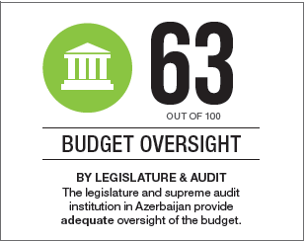

Slide 25
 |  | Budget oversight by Legislature & Audit | Of which
 |  |  | Parliament |  | SAI
 |  |  | Formulation/ Approval | Execution/ Audit
1 | Azerbaijan | 63 | 52 | 53 | 83
2 | Russian Federation | 78 | 72 | 80 | 83
3 | Moldova | 59 | 48 | 47 | 83
4 | Kazakhstan | 63 | 67 | 73 | 50
5 | Kyrgyz Republic | 74 | 91 | 47 | 78
6 | Ukraine | 83 | 86 | 87 | 78
7 | Turkey | 59 | 62 | 33 | 78
8 | Georgia | 74 | 52 | 87 | 89
9 | Tajikistan | 65 | 48 | 87 | 67
10 | Bulgaria | 59 | 67 | 33 | 72
11 | Croatia | 59 | 53 | 33 | 89
12 | Czech Republic | 82 | 91 | 67 | 83
13 | Hungary | 65 | 76 | 13 | 95
14 | Macedonia | 56 | 62 | 20 | 78
15 | Poland | 82 | 67 | 87 | 95
16 | Romania | 63 | 53 | 67 | 72
17 | Serbia | 63 | 43 | 67 | 83
18 | Slovak Republic | 56 | 67 | 20 | 72
19 | Slovenia | 80 | 67 | 93 | 83

Slide 26
How can Azerbaijan improve oversight?
Country should prioritize the following actions to make budget oversight more effective:
Ensure a legislative committee examines and publishes a report on the Audit Report online.
Ensure audit processes are reviewed by an independent agency.

Slide 27
Conclusions of OBI & PEFA for Parliaments and Supreme Audit Institution
“Performance culture” need for adopt new fiscal oversight institutions in Azerbaijan. For example, performance (or result-oriented) budgeting and performance audit (or value for money)
The Parliament also should take more measures to publicize the outcomes of the audits in order to increase transparency and accountability. So that in accordance with the legislation, the Chamber of Accounts presents the results of each audit to the Parliament.
Main targets for improve Budget Oversight

Slide 28
THANKS FOR YOUR ATTENTION

