Slide 1
Progress report on the subproject "KNI systems and public governance"
11th Meeting of the INTOSAI Working Group on
Key National Indicators
Rome, March 27th, 2018

Slide 2
Overview
9th Meeting of the INTOSAI WG on KNI, Armenia (2016)
Federal Court of Accounts - Brazil (TCU) responsible for the subproject “Key National Indicator Systems and Public Governance”

Slide 3
Overview
9th Meeting of the INTOSAI WG on KNI, Armenia (2016)
Federal Court of Accounts - Brazil (TCU) responsible for the subproject “Key National Indicator Systems and Public Governance”
January 2017
(1st step)
Survey sent to all INTOSAI members
Notes:
- 47 SAIs (24% of INTOSAI members)
- 13 WG-KNI members (59% WG)

Slide 4
Overview
9th Meeting of the INTOSAI WG on KNI, Armenia (2016)
Federal Court of Accounts - Brazil (TCU) responsible for the subproject “Key National Indicator Systems and Public Governance”
January 2017
(1st step)
Survey sent to all INTOSAI members
47 SAIs (24% of INTOSAI members)
13 WG-KNI members (59% WG)
Notes:
- 47 SAIs (24% of INTOSAI members)
- 13 WG-KNI members (59% WG)

Slide 5
Overview
9th Meeting of the INTOSAI WG on KNI, Armenia (2016)
Federal Court of Accounts - Brazil (TCU) responsible for the subproject “Key National Indicator Systems and Public Governance”
January 2017
(1st step)
Survey sent to all INTOSAI members
10th Meeting of the INTOSAI WG on KNI, Brazil (2017)
Survey results presented

Slide 6
Survey structure
Part 1
KNI
Part 2
Public Governance
Part 3
Connection between KNI and Public Governance

Slide 7
Survey structure
Part 1
KNI
Part 2
Public Governance
Part 3
Connection between KNI and Public Governance

Slide 8
Connection between KNI and Public Governance
11. Has your SAI already conducted or is planning to carry out works that address the connections between governance, good governance and government use of KNI?

Slide 9
Connection between KNI and Public Governance
11. Has your SAI already conducted or is planning to carry out works that address the connections between governance, good governance and government use of KNI?
The connection between KNI and Pubic Governance is not evaluated by most of the SAIs

Slide 10
Examples of Audit Work
Notes:
Austrian Court of Audit – two audits: “The impact of legal and HRM measures on the effective retirement age in selected ministries” and “Quality of midterm budget planning”

Slide 11
Examples of Audit Work
Enterprise Risk Management
Data-Driven Decision Making
US GAO
Notes:
Austrian Court of Audit – two audits: “The impact of legal and HRM measures on the effective retirement age in selected ministries” and “Quality of midterm budget planning”

Slide 12
Examples of Audit Work
Enterprise Risk Management
Data-Driven Decision Making
US GAO
Quality of midterm budget planning
The impact of legal and HRM measures on the effective retirement age in selected ministries
Austrian Court of Audit
Notes:
Austrian Court of Audit – two audits: “The impact of legal and HRM measures on the effective retirement age in selected ministries” and “Quality of midterm budget planning”

Slide 13
Examples of Audit Work in the TCU
Notes:
Austrian Court of Audit – two audits: “The impact of legal and HRM measures on the effective retirement age in selected ministries” and “Quality of midterm budget planning”

Slide 14
Examples of Audit Work in the TCU
TCU OECD Project
SDG Project
TCU
Notes:
Austrian Court of Audit – two audits: “The impact of legal and HRM measures on the effective retirement age in selected ministries” and “Quality of midterm budget planning”

Slide 15
SDG Project
Goal of SDG Project
Build capacities and develop methods and tools in order to prepare TCU to review the implementation of the Agenda 2030 by the Brazilian Government, with the possibility of replication of the method by other Audit Institutions.

Slide 16
SDG Project
Initiatives
Government’s PREPAREDNESS to implement SDGs
Pilot audit
2016
2017
Latin America Audit
Audit model
Capacity building

Slide 17
SDG Project

Slide 18
SDG Project
2.4 Sustainable food production systems
By 2030, ensure sustainable food production systems and implement resilient agricultural practices that increase productivity and production, that help maintain ecosystems, that strengthen capacity for adaptation to climate change, extreme weather, drought, flooding and other disasters and that progressively improve land and soil quality

Slide 19
SDG Project – Audit model
Center of Government
Agency A
Agency B
Policy A
Policy B
Policy C
whole-of-government approach
cross-cutting
SDG Target
SDG Target
SDG
Target

Slide 20
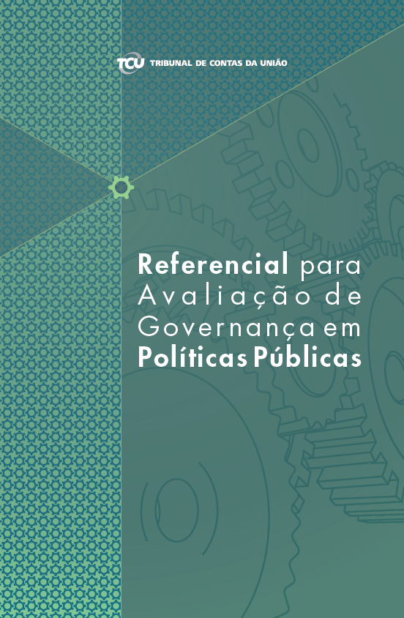
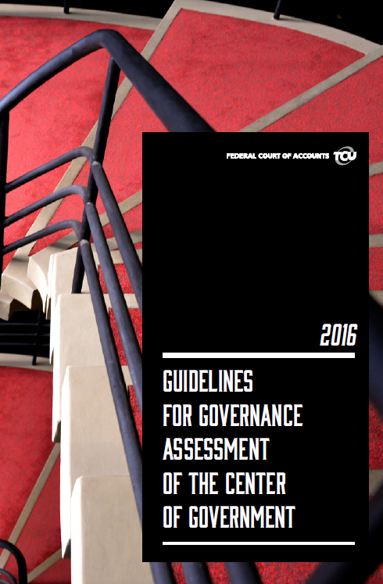
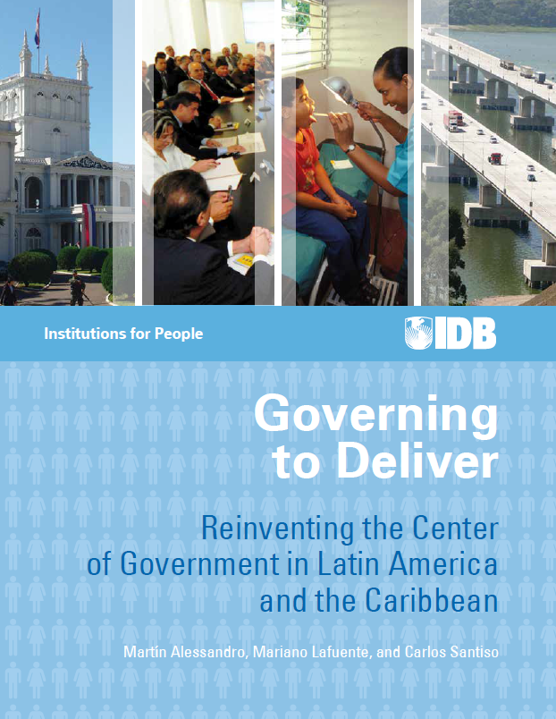
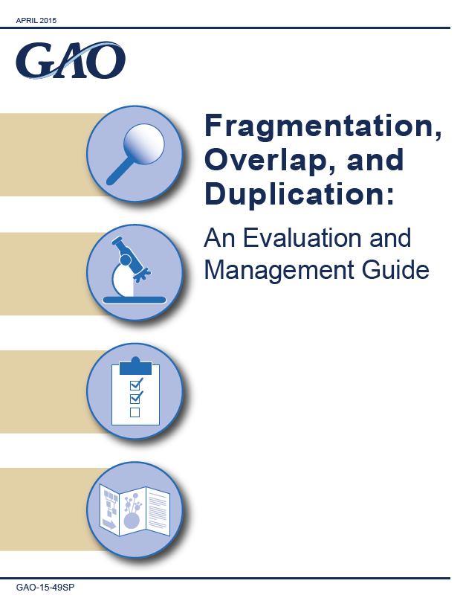
SDG Project

Slide 21
SDG Project
Pilot audits findings
Deficiencies in SDG institutionalization
Lack of a national long-term plan
Non-integration of mechanisms for monitoring public policies
Lack of horizontal coordination among public policies, leading to fragmentation, overlapping and duplicities

Slide 22
TCU – OECD Project
Improving decentralized government policies and programmes through outcome-driven auditing

Slide 23
TCU – OECD Project
2018
2019
2020
2021
Product 1
Framework for the oversight of decentralised policies
Product 2
Framework for monitoring the outcomes of Decentralized Government Policies
(based on the Indicator Integration Model)
Product 3
Model to assess the maturity of public policy governance
(emphasis on the federative coordination)
Coordinated Pilot Audit using developed models
Final product
Strategy for Coordinated Oversight of Decentralized Government Policies

Slide 24
Proposal

Slide 25
Proposal
Selection of works involving KNI, public governance and Sustainable Development Goals that are useful for the INTOSAI community
Send a form to the SAIs that conducted the selected works

Slide 26
Form – Information required
Objective
Type of activity
Scope and methodology
Timing and resources
Benefits and outcomes
Good practices used
Lessons learned
Criteria

Slide 27
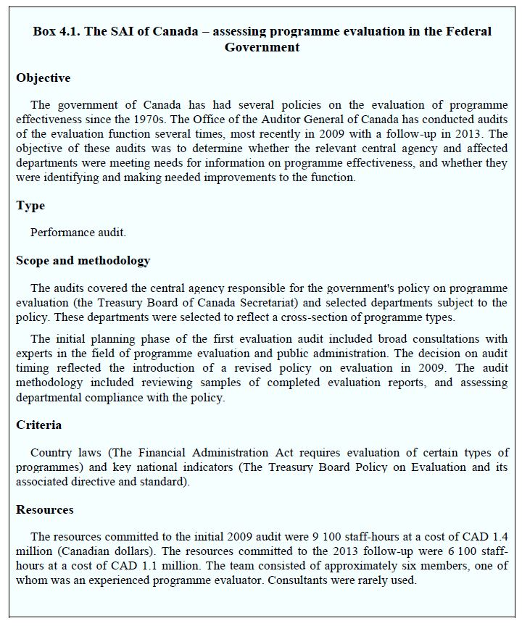
Report
Report
to be shared with
INTOSAI community
Source: Supreme Audit Institutions and Good Governance: Oversight, Insight and Foresight © OECD 2016

Slide 28
Thank you!
Leonardo Naves Sousa
Leonardons@tcu.gov.br

