Slide 1
Benchmarking information Exchange project - NEWS
Radka Domanská
Štefan Kabátek
Bratislava, April 2019

Slide 2
WHY international comparison?
other approaches to the audited area
identification of international good practice
recommendations in accordance with good practice
better feedback to both citizens and public budget administrators
International Standards of Supreme Audit Institutions (ISSAI)
is a tool for international comparison

Slide 3
What is BIEP?
Benchmarking Information Exchange Project
easy and flexible cooperation
from infomation exchange to national or international comparison
identification of good practice in public administration
possibility of comparison in any area
help with setting audit criteria

Slide 4
What is shared within BIEP?
publicly available information
data from information systems
audit results or other experience with the topic
comparison proposals
at the strategic level (system)
at the operational level (KPIs)
methodologies
BIEP results

Slide 5
BIEP principles of cooperation
SAIs can suggest a new topic for benchmarking and express interest in any topic
SAIs can join a topic anytime
SAIs can use already existing methodologies or create a new one
SAIs share the BIEP results and other documents in one place - BIEP Portal
SAIs can use the BIEP results for its own national reports upon approval of all cooperating SAIs in the given topic
1
2
3
4
5

Slide 6
BIEP Portal
new IT platform for data sharing (previously Extranet)
public and non-public part
every SAI can join BIEP Portal
data sharing at the performance level (auditor – auditor)
90 users from 33 countries
currently 15 topics open
documents
discussions

Slide 7
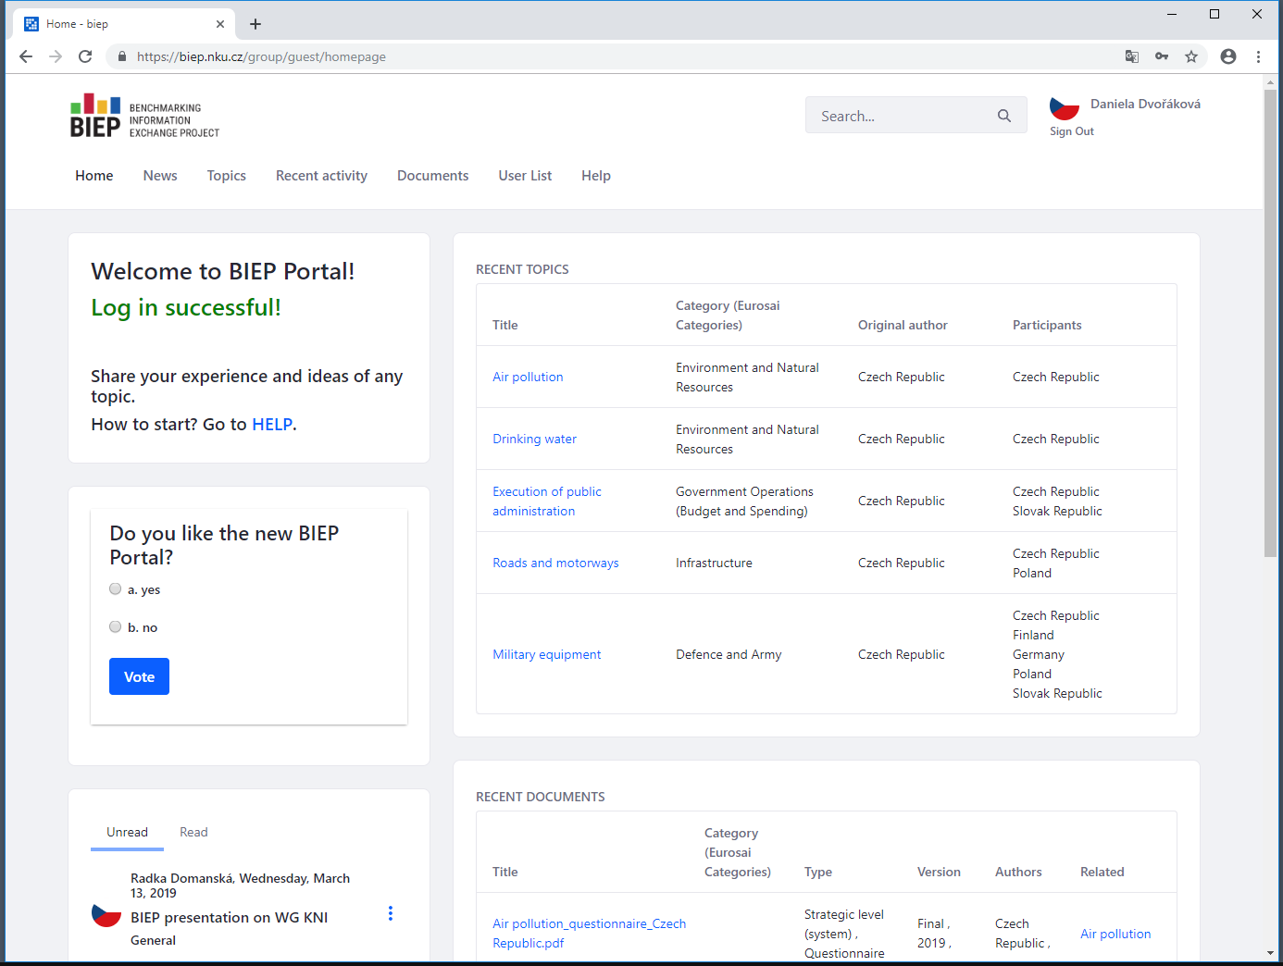
BIEP Portal
biep.nku.cz

Slide 8
BIEP topics
First BIEP results
Immovable property
A questionnaire conducted
Other topics
Drinking water
Centralized public procurement
Social housing
Implementation of SDGs
Road and motorways
Digital education
Military equipment
Crime prevention
Air pollution
Toll system
Wi-Fi on trains
Execution of public administration
Social services
Excise duty

Slide 9
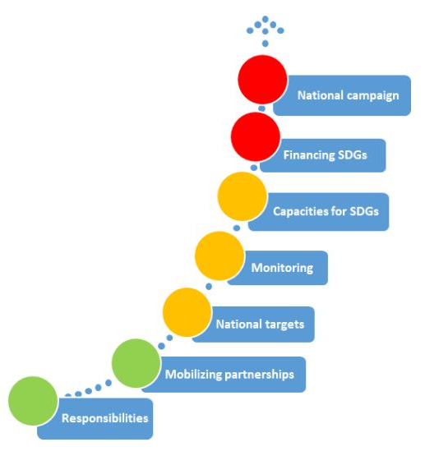
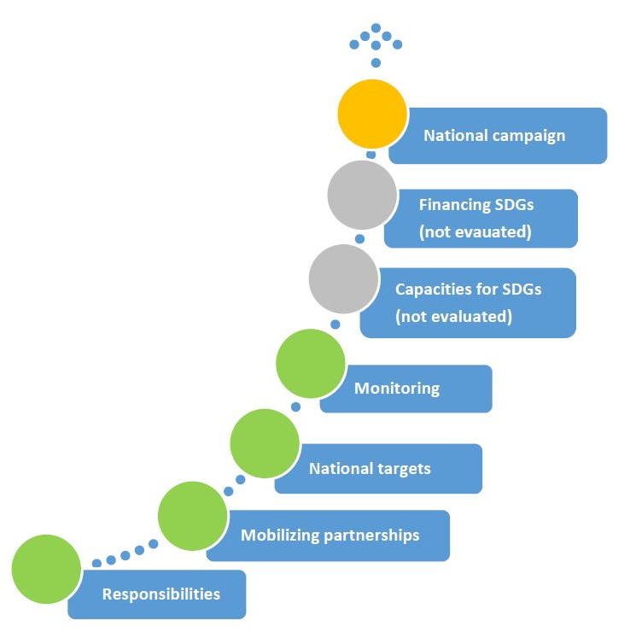
Topic: Implementation of SDGs
Slovakia
the Czech Republic
an audit
publicly available information
Note to colors: the process which is sufficiently secured
if some initial steps have been done
if no significant steps have been done
areas were not evaluated

Slide 10
Topic: Air pollution
EU members are obligated to monitor „Average Exposure Indicator“ for fine particulate matter PM_{2,5}.
[EU Directive No. 2008/50/EC]
SAO CR examined the method of indicator calculation and identified the risk that the Czech Republic did not meet the objective of reducing the fine particle exposure.
[the audit called “Funds earmarked for supporting air quality improvements”]
SAO CR prepared a questionnaire to find out how is this indicator calculated in other countries and whether calculated values are comparable.
[BIEP cooperation]

Slide 11
Synergy between WG KNI and BIEP
WG KNI
facilitate information and knowledge sharing among SAIs
help to promote an increase of efficiency, transparency and public trust
International comparison
identify good practice
set up the audit criteria
BIEP is a one of the tools
worldwide communication and cooperation
information exchange
comparison
inspiration

Slide 12
Topic: Use and development of KNI?
Guidance – categories of criteria and corresponding questions
legal and methodological framework for the performance and impacts measurement system
sufficiency and relevance of the indicators set
the quality of the indicators set
coherance of the performance and impacts measurement system with other activities
feasibility and soundness of indicators values
adequancy of monitoring and evaluation procedures applied within the performance and impact measurement system
opportunities: discussion within BIEP platform, questionnaire

Slide 13
BIEP and 3C principles
EASY communication
BETTER cooperation
MORE comparisons

Slide 14
Thank you for your attention
Radka Domanská| radka.domanska@nku.cz
Štefan Kabátek | stefan.kabatek@nku.cz
Team BIEP | biep@nku.cz
Czech Republic| Supreme Audit Office| www.nku.cz

