Slide 1
SAIs and SDG 16
PFM Reporting Framework for
African Supreme Audit Institutions
Dr. Barbara Dutzler
Good Financial Governance in Africa Programme
Working Group on KNI,
Rome, Italy, 27-28 March, 2018

Slide 2
AFROSAI Regional Paper for INCOSAI Theme I
SDGs are an opportunity for rethinking the engagement of SAIs in auditing government operations and governance questions.
Public Financial Management
Catalyst for government performance
and reframe the of PFM systems
SAIs to rethink review and audit
To maximize the contribution to achievement of other SDGs.
Notes:
Our core proposition – the theme of this presentation. Some background – status quo, what have we found through our research. Then the key questions: what exactly can SAIs do about this? And then, our intervention, the framework we designed and some preliminary results.

Slide 3

Notes:
Core research question:
Well-functioning PFM systems are fundamental for success of the SDGs.
This is a hypothesis but with no proven connection that such a link exists.
In our search for defining the role of SAIs in the auditing of SDGs, focusing on goal 16, I believe we have found evidence for such a link. SAIs can make a contribution to SDGs by auditing PFM in a holistic way

Slide 4
Notes:
The top 12 most common areas of poor performance – and you will note that all procurement indicators belong to this category, they are a concern in about 60% of countries reviewed.

Slide 5

The challenge
SAI audits repeatedly reveal these financial management weaknesses.
However, many of these are not followed up nor systematically addressed.
Why?
Notes:
We contracted some PFM experts for assistance, namely ODI – there is surprisingly few PFM practitioners and academics, there are really just a few: IMF, Harvard, ODI. And on AFROSAI-E invitation we workshoped their input together with 6 African SAIs: Ghana, Kenya, Mozambique, Uganda, Zimbabwe South Africa

Slide 6
Lack of technical understanding of what needs to change
Lack of resources to implement the necessary changes
Lack of political will to make the necessary changes
Lack of follow up to audit reports
Audit findings are difficult to understand and interpret
Audit findings are not sensitive to, or situated within, wider understanding of PFM systems and therefore lack relevance to PFM managers
Notes:
- Not just identify the problem, but root causes, and then draw some recommendations/ideas on why the problems are arising

Slide 7
Situating audit findings in wider PFM systems
Improve relevance of audit findings by relating them to actual system or sub-system operation
  Improve impact of audit findings by making them more cognisant of wider PFM interlinkages
  Support the development of wider-ranging focus on functionality that goes beyond narrow compliance/control focus or full-fledged 3-E approach
Key is to understand how the PFM system operates
Notes:
And then to communicate it.
Making findings relevant – this problem relates
Improve impact – not just identifying individual problems, but some of root causes
Auditing PFM example of performance audit – trying to understand how the PFM system operates - and that is a surprisingly difficult question

Slide 8
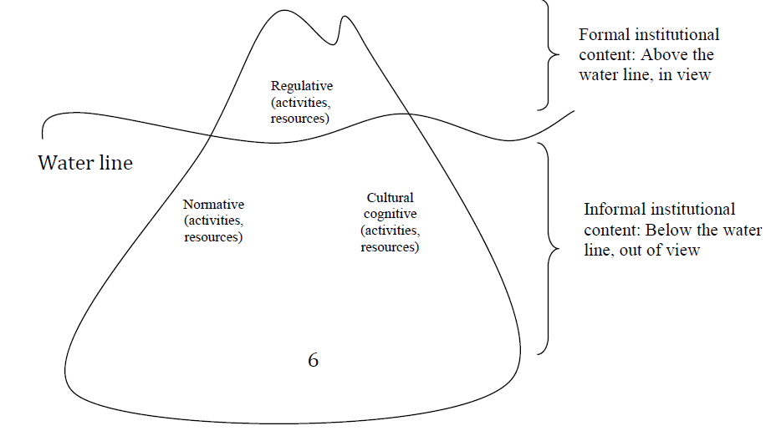
Institutional structures as icebergs
Source: Andrews, 2014
Notes:
There are at least 2 distinct challenges here that makes it difficult to understand the wider PFM system.
The first relates to the limits of institutional change (Andrews, 2014). The figure above shows the institution as an iceberg in which normative and cultural cognitive mechanisms form a base atop which regulative devices operate. This approach has parallels with Elinor Ostrom’s ‘nested’ rules (Ostrom 1990, 51). Together, the elements establish a rule that shapes the way agents think, weigh decisions, and behave. It is important to note that this kind of structure incorporates both informal and formal elements—not one or the other. The iceberg metaphor reflects this, suggesting that a large part of any institutional mechanism is unseen or below the water line because it is informal—implicit, unwritten and seldom visible. (Andrews, 2014).
Externally supported Public financial management (PFM) reforms often have limited success in developing countries.

Slide 9

  PFM systems can ‘look good’ from the outside but fail to deliver anything useful
Notes:
The second relates to the implementation of best practice reforms: how a system operates may not be how it is described. In particular when it is something that is best practice – move to accrual accounting. Mtef. Program based budgeting. May all produce something that is not useful.

Slide 10
PFM: Form over Function?
Formal Features | Functional Features
De jure Legislation, intention | De facto Implementation, compliance, enforcement
Upstream in budget cycle Planning, budgeting | Downstream in budget cycle Cash management, accounting, reporting and audit
Performance improvement 2001-2010 in 32 countries De jure 28% De facto 16%
* WB Evaluation
Notes:
These are academic concerns, but we find evidence for it. 2012 WB evaluation on PEFA scores.
The issue is to adress the functional features rather than the formal ones. Compliance is not enough – on procurement, most laws respect international best practice, the AU Convention against corruption, etc. But we want to know about functionality: is a process working as it should? Does it deliver the desired results? So, how do we go about it?

Slide 11

What can SAIs do about this?
Notes:
Sticky problems. With all this in mind: what can SAIs do about this
After all, this is the core mandate of SAIs..

Slide 12
SAIs are uniquely placed to assess PFM functionality
Multi-disciplinary
Multi-dimensional
Multi-departmental
Multi-level
SAIs
Central level
Policy setters
Local government
Spending Ministries
Multi-international government departments
Multi-departmental
Multi-disciplinary
Multi-jurisdictional
Notes:
There is a prominent role to be played by the SAIs, as a result of their unique placement as oversight body over the whole of public finance. SAIs stand to benefit from this high level tool that addresses the PFM risks along the PFM cycle for a country by assessing the policy & regulatory, operational (organisation, HR capacity & IT), and governance risks elements of core institutions shaping and implementing PFM in a country.

Slide 13
The PFM Reporting Framework Approach
Financial Sustainability is a system’s capability of delivering prudent fiscal decisions such that over the medium-to-long term the budget is balanced
Multi-disciplinary
Implementation of policy priorities occur when budgets are credible and institutions are capable of delivering on national priorities through their planning and allocation processes.
Service delivery depends on reliable and efficient use of allocated funds implemented by accountable institutions.
Functional PFM System
Multi-international government departments
Multi-departmental
Risks and Threats
Key Stakeholders
Ministry of Finance
Revenue
Authority
Parliament
Spending Ministry
Education
Spending Ministry Health
Multi-jurisdictional
Notes:
Given that there is no conclusive view on what constitutes a functioning PFM system, we started with the 3 core objectives it must fulfil.
Agreggate spending control
Effective allocation of funding to priorities
Operational efficiency of allocated funds
And discussed, in our workshop last year October, what core risks and evidence of good performance are.

Slide 14
Examples of functional PFM processes according to objectives
Policy implementation
Budgets are comprehensive and credible
Spending reflects budget as approved
Service Delivery
Cash provided on time to MDAs
Quality procurement executed as planned
Sustainability
Spending decisions are affordable
Contingent liabilities quantified
Notes:
Important to have a balance between form and function:
Form is easy to check, function much less. Which is why we may have an emphasis on form. Is there an MTEF – yes. Does it determine the spending and provide a reliable fiscal framework for 3 or 5 years – you have to go through the entire budget documentation for this. Rather difficult.

Slide 15
PFM Reporting Framework
The PFM Reporting Framework is geared for SAIs to identify the most relevant PFM risks present in their country
It draws on existing information by collecting findings in a light diagnostic tool.
It allows for a systemic thematic synthesis across all individual entities that a SAI audits
Benefits
The tool highlights weaknesses for each department or entity.
The summary generates a holistic picture and allows for a comparison across all core players
Notes:
The GFG in Africa Programme together with AFROSAI-E is in the process of developing a methodology that will highlight the key systemic and institutional risks that countries face with regards to PFM. The output of this research will be a diagnostic tool for SAIs, to be used for audit planning (risk assessment) and reporting on country and regional level.

Slide 16
The PFM RF looks at policy and spending level..
Process
PFM Output
Ministry of Finance
Revenue Administration
Parliament
Ministry of Education
Ministry of Health
Ministry of Public Works
Ministry of Agriculture
Key Question
Covering 80% of spending
Most important MDAs or
most relevant SDG areas
Notes:
This includes also uncomfortable entities, such as Ministry of Defense, or Interior / Police, or Local Government.

Slide 17
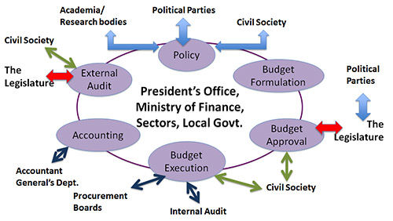
…across the PFM cycle..
Notes:
Focus on that part of the cycle. Links to policy, through national development plan / SDG, and given there are instruments like SAI PMF not focusing on SAIs. But could be linked in later step to get full picture.

Slide 18
…addressing five root causes…
PFM reporting framework
A. Policies and Legal Framework
B. Operations – Organisations (processes) and People (capacity)
C. Information Systems
D. Governance & Oversight
E. Communication and Stakeholder Management

Slide 19
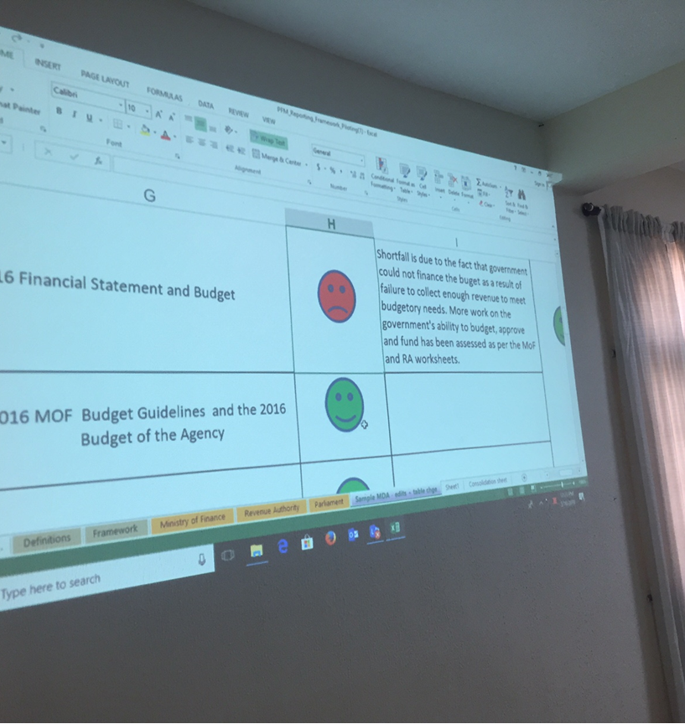
… mapping risk areas for country PFM systems.
Notes:
The tool creates a heat map or ranks the various components to come up with a threat and risk assesment.

Slide 20
A flavour of the tool..
PFM Process
PFM output
Key Question

Slide 21
.. differentiating between policy setting and implementation. Example: budget execution
Cash Management
MoF
Does MoF ensure MDA spending is in line with approved budget?
Is there a clear and documented process for release of cash, and is it adhered to?
Cash Management
MDA
Does MDA have commitment controls to ensure spending is in line with budget?
Does MDA submit regular and complete expenditure and performance reports?
Are reconciliations between spending and approved plans done monthly?
Are in-year cash allocations to MDAs aligned with budget and released in line with spending requests?
Notes:
Pfm process: budget execution. PFM output: cash management. Key question: xxx.

Slide 22
..resulting in a summarized heatmap across all PFM institutions

Slide 23

Test phase
in sheltered atmoshpere

Slide 24
Approach to piloting:
Continuity from development phase
  Involvement regional peers who developed the tool,
  Self-assessment possible, but testing phase coached self-assessment to understand weaknesses of tool
Pre-Workshop:
  Tool, PEFA report, heatmap report distributed beforehand
  SAI to research its reports, documents, findings on selected MDAs
Workshop in country
  Mixed teams of financial, compliance, performance auditors
  Knowledge teams per MDA
1 day intense discussion on methodology and tool
2 days filling of framework

Slide 25
First results from piloting
„eye opener“
Time to get used to approach: „value judgement“, level of detail required
Research beforehand crucial
Guidance from mentors required
Requires triangulation of information:
  not take information from MDAs at face value
  Not take mentioning of policy document (e.g. NDP) as evidence budget is in accordance with NDP
The outcome: an analysis. Not more. Not less.

Slide 26

Outlook:
How do SAIs use this information?

Slide 27
Possible use
In reporting
  As national PFM performance report
  As chapter in annual report on PFM
  As contribution to analysis of cross-cutting concerns such as procurement or non-tax revenue
In audit planning
  Risk analysis as input to annual audit planning
  Risk analysis for targeting focus for specific questions or entities
In analytics / research
  Review change of performance over time

Slide 28
Thank you for your attention

