Slide 1

Better indicators for better fiscal policy
12th meeting of INTOSAI Working Group on Key National Indicators
April 2nd, 2019, Bratislava
Ivan Šramko

Slide 2
Introduction of the Council
Council for Budget Responsibility – an independent authority for monitoring and evaluation of Slovak public finance
Established by the constitutional act on fiscal responsibility in 2011 as a part of a new fiscal framework
Provides strictly positive policy assessment (as opposed to normative evaluation)
Four main tasks of the Council
  evaluating the fulfillment of fiscal and transparency rules
  reporting on long-term sustainability
  assessment of legislative proposals
  monitoring and evaluation of meeting budget’s targets

Slide 3
The context: SK fiscal framework
“… with a view to achieving long-term sustainability of public finances in the Slovak Republic”
CBR
Limit for boundary situations, when other tools for budget managementwere not used
The debt ceiling
Limits on public expendi-ture
Fiscal rules for munici-
palities
Trans-parency
rules
Operational fiscal rule promoting long-term sustainability
Net worth

Slide 4
Key concepts
Public debt, its level and development
  Subject to the numerical limits with sanctions
  Safe debt level as a desired objective
The long-term sustainability indicator
  Adjustment in the structural balance needed to keep debt below the limit in the long-term
Structural balance of the general government
  Fiscal strategy of the government in the short- and medium-term
Net worth of the public sector
  Key principle that should govern all other assessments
Comparison with EU rules: reflecting country specifics, greater concern for long-term developments -> currently more demanding

Slide 5
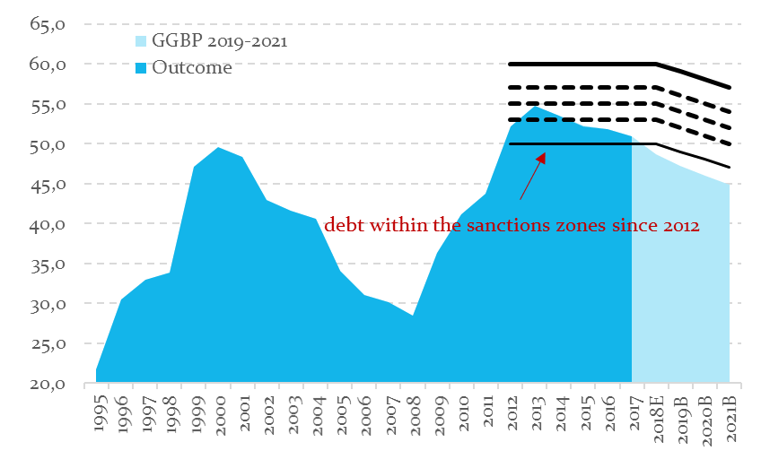
The public debt and its limit
The ceiling for the public debt level is at 50 % of GDP (limit is temporarily set higher and gradually declines: at 59 % GDP in 2018)
Any rule can be circum-vented, therefore a strict limit is needed in order to prevent the accumula-tion of excess debt
The sanction zones are activated 10 p.p. below the constitutional limit
Escape clauses are unam-biguously defined
Public debt in Slovakia and sanction zones (% of GDP)
Source: Statistical Office of the SR, Ministry of Finance, CBR

Slide 6






Long-term sustainability
Solvency
Growth
SUSTAINABILITY
Stability
Fairness

Slide 7
Sustainability - principles
Solvency: intertemporal budget constraint, target debt level, both stock and flow variables
  Baseline scenario: public finance development under current policy frameworks, economic and demographic assumptions without any new government intervention
Stability: tax smoothing, sensitivity analysis
Growth: links between macro and fiscal scenario
(mainly through investment and taxes)
Fairness: impact on generations, no normative assessment

Slide 8
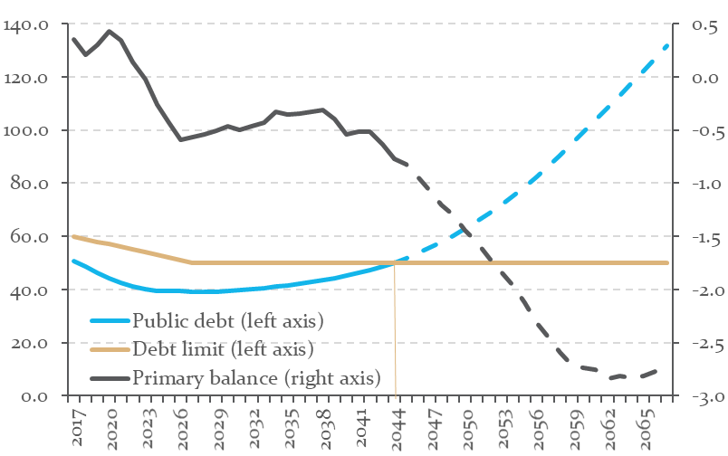
Long-term forecasts for public debt and primary balance
Projected levels of public debt and primary budget balance in a no-policy change scenario (% of GDP)
Assumed positive values of the primary budget balance
Long-term sustainability of public finances in Slovakia requires that the public debt remains at the safe levels below 40% of GDP
Failure to decrease the debt stock deteriorates readiness of public finances for aging; as a result, the public debt grows above safe limits and endangers long-term sustainability of public finances
+ 92 % of GDP
Negative impact of demography on the budget balance will increase
Source: CBR, Report on the Long-term Sustainability of Public Finances for 2017, April 2018

Slide 9
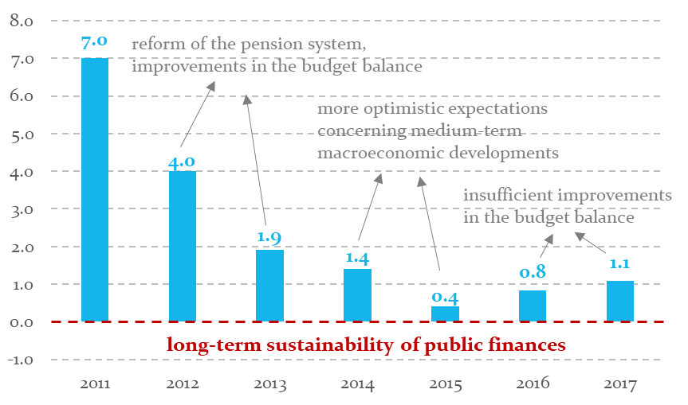
Development of the long-term sustainability in recent years
Changes in the long-term sustainability indicator (% of GDP)
Since 2011, a substantial improvement has been achieved in terms of the long-term sustainability
In order to keep the public debt level below the upper debt limit (50 % of GDP) in 50 years time-horizon, it is necessary in the medium-term to adopt additional consolidation measures amounting to 1.1 % of GDP.
Notes: The indicator expresses a permanent increase in the public revenue level or a permanent decrease in the public expenditure level required to keep the public debt below the threshold of 50% of GDP in 50 years time-horizon.
Source: CBR, Report on the Long-term Sustainability of Public Finances for 2017, April 2018

Slide 10
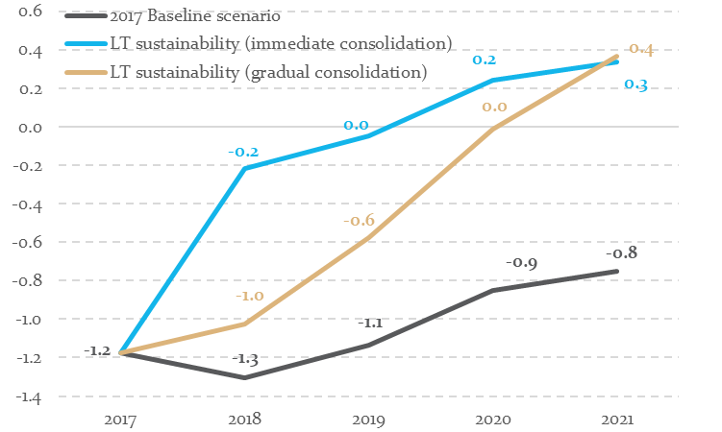
Medium-term implications of long-term sustainability
Structural balance in medium-run (% of GDP)
The long-term sustainability indicator can be transformed into medium-term fiscal targets (structural balance)
Achieving long-term sustainability in 4 years horizon would require a structural surplus of 0.3-0.4% of GDP by 2021
Source: CBR, Report on the Long-term Sustainability of Public Finances for 2017, April 2018

Slide 11
Fiscal space review
Fiscal space review is a comprehensive assessment of fiscal risks
The outcome: quantification of optimal/ prudent levels for public debt
To be prepared at 4-year frequency, first in 2020

Slide 12
Net worth of the public sector
Net worth is the total equity of public sector adjusted for the implicit and contingent liabilities, as well as for other assets and liabilities
We do not know the “balance-sheet” of the state
Additional work needed to improve the analysis of net worth
Net worth including future activities
Degree of uncertainty
Net debt
Net assets
Gross debt
WGA
Degree of complexity

Slide 13
  Net worth in the public accounts
Intertemporal net worth should become an important part of the state closing accounts in the future
ASSETS | LIABILITIES
A1 – Buildings, land, etc. | P1 – Explicit debt
A2 - Infrastructure | P2 - Implicit liabilities;
A3 – Net capital stock | P3 - Contingent liabilities;
A4 – Financial assets | P4 – Other liabilities
A5 – Net worth of the central bank | Net worth
A6 – Net worth of state corporations
A7 – Natural resources
A8 – Ecological wealth
A9 – Other assets

Slide 14


