Slide 1
1-The project of developing the national framework for measuring the governmental performance of the State of Kuwait Audit Bureau's
2- vision on the draft audit manual on the use and development of INTOSAI's national performance indicators
Prepared by
Khaled AlShihab
Senior auditor
Company sector
Salah Alkhudari
Division head
IT department
INTOSAI WGKNI – Work Shop
Slovakia /Bratislava 2-4 / 04/ 2019

Slide 2
Presentation contents
- Developing the national framework for measuring government performance in Kuwait
Project Definition
Project goals
Project phases
The opinion of SAB on the INTOSAI guidance audit of the use and development of KNI

Slide 3
Vision
Contribute to the support, empowerment and enrichment of the entities covered by the state Audit Bureau of Kuwait to enable them to provide a strategic vision in line with the developmental requirements of State of Kuwait, including the tools and standards of performance measurement and to facilitate the easy evaluation of the performance of the plans and development programs of the State. This is in line with the main objectives of establishing the state Audit Bureau of Kuwait and rational use of public funds.

Slide 4
Kuwait vision 2035

Slide 5
Project divination
The project included the design and experimentation of the national framework for measuring government performance in Kuwait and related to improve the capacity of the SAI to protect public money, in cooperation with the targeted entities
Education sector | Oil sectors | Health Sector
With a view to improving performance in a sustainable manner and ensuring the efficient use of available resources

Slide 6
Project Definition
In an initiative of SAB, the project of National Performance Development and Measurement was launched in cooperation with the United Nations Development Program (UNDP), which aims at consolidating the principles of (governance, transparency, performance control, risk management).
With the participation of SAB as supervisor, the General Secretariat of the Supreme Council for Planning and Development as project organizer, the (UNDP) as a project sponsor, PricewaterhouseCoopers Cooper is a project consultant.
The contract was signed on 17/7/2016.

Slide 7
Project stakeholders
UNDP
General Secretariat of the Supreme Council for Planning and Development
State audit bureau of Kuwait
Central Statistical Bureau
Government entities
PWC

Slide 8
Project Goals
Developing the national framework for measuring government performance
1
Emphasis on governance and transparency
2
Developing strategic plan for government entities
3
Developing key Performance Indicators
4
Monitor the implementation of approved KPIs
5

Slide 9
Project Goals
1. developing the national framework for measuring institutional performance in cooperation with the project stakeholders.
2. Develop mechanisms to enhance governance, transparency, credibility, integrity and rationalization of government spending.
3. Ensuring on the development of strategies of the government entities aligned with the national development plan and the vision of the State 2035
4. Design KPIs that reflect the actual level of government performance and measure it as a target and compare it to what is done in the benchmark countries.

Slide 10
The importance of the project
1. To strengthen the culture of performance measurement to compare the financial cost and the quality of services.
2. Evaluate the effectiveness of governance and transparency systems that are aligned with relevant SDGs.
3. Design KPIs and establish models for data collection to enable the targeted sectors to measure their performance.
4. Train SAB auditors and the targeted sectors to implement and activate KPIs

Slide 11
Project phases
Initiating Phase
phase 1: gap analysis.
phase 2: Designing the framework
phase 3: KPI Design
phase 4: Training

Slide 12
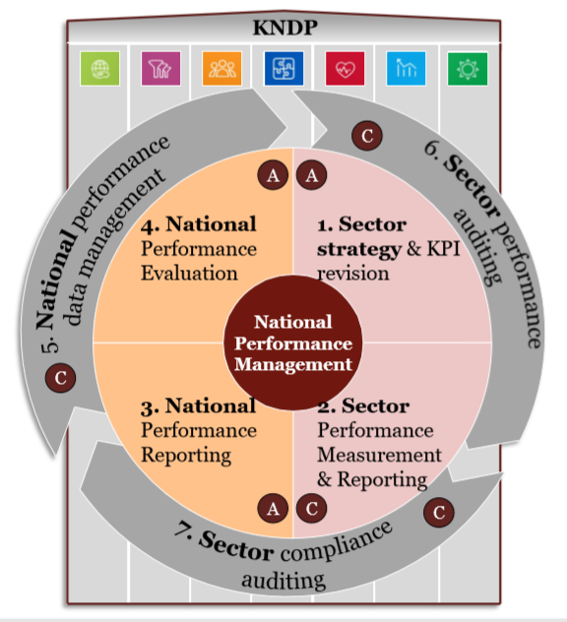
Designing the national framework for
measuring performance

Slide 13
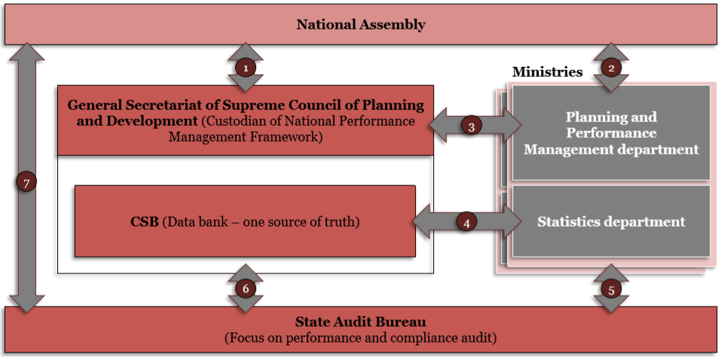
Governance model

Slide 14
Designing KPIs for targeted government entities
Based on the study that was prepared and the discussions that were carried out and in agreement with the targeted sectors ,
the indicators selected were based on two main elements: (cost and benefit).

Slide 15
The expected outcome of the project
Enhancing the capacity of SAB to assess and monitor national performance.
Enable the government entities to develop a strategic thinking towards managing and improving performance.
Design of the operational model and enabling tools for performance indicators in the targeted entities.
Design key performance indicators, reporting formats and information flow processes.

Slide 16
Future prospects for applying national indicators to measure performance
Host a high-level conference related to the project to be targeted to the leaders in all the entities covered by SAB to explain the project and its values.
To include the performance indicators report in the annual report of SAB
Activate the role of audit teams of SAB to follow up the government entities
host a conference or workshops by SAB to discuss the issue of national performance indicators (KNI) for the SAIs.

Slide 17
Future prospects for applying national indicators to measure performance
Automating the hall project, including the KPIs, after ensuring their adoption manually, which achieves all the advantages of applying the automated systems, including the accuracy of data and results and the availability of statistics and reports in a timely manner, facilitating the decision making process for the purpose of improving performance.
The project will be expanded to all government entities.
Benefiting from the experience of (INTOSAI) members through participating in special conferences and workshops to discus subjects relate to KNI.

Slide 18
The opinion of SAB on the audit manual for the National Performance Indicators for INTOSAI
The draft of the manual referred by WGKNI was received by the Kuwaiti state Audit Bureau. The Kuwait state audit bureau has carefully studied the guide and has shown his opinion based on the guidance received and been sent in advance. Our opinion can be illustrated as follow :
1). The Kuwait Audit Bureau agree with paragraph (38) of the proposed standard for auditing performance indicators which indicates the need of independence of sovereign regulators in the preparation and selection of performance indicators, since this task is the responsibility of governments.

Slide 19
The opinion of SAB on the audit manual for the National Performance Indicators for INTOSAI
2) It is important to summarize what's been stated in the manual without under estimating the principles contained in order to facilitate the use of the guide and to achieve the objective of the guide considering that it will be used by the auditors of the SAIs, whose experience and capabilities vary and the guide should be easily be understood and used .
3) The time frame for performing the review of the national performance indicators (quarterly, semi-annual) should be determined or subject to the decision of the SAIs each individual, considering that some performance indicators are linked to a time, quantitative or qualitative framework.

Slide 20
The opinion of SAB on the audit manual for the National Performance Indicators for INTOSAI
4) Point (30) Page 8 regarding the Performance Indicator Review Criteria (Policy Review and Evaluation Criteria).
(To carry out public policy evaluations at all stages of the process)
Which requires clarification of this role, especially the evaluation of policies, which is usually the responsibility of parliaments taking into account that the role of SAIs depends on the laws and constitution of each state.
5) Clarification of the application of indicators and how to benefit from their results through continuous development.
6) Compliance audit should be included in a special section of the manual that addresses audit steps so that SAIs can apply this type of audit for the seek of its importance.

Slide 21
The opinion of SAB on the audit manual for the National Performance Indicators for INTOSAI
7) Point (36) page (9) from the manual stated the following:
(Given their unique roles and responsibilities within national governments in helping to promote transparency and ensure performance and accountability SAIs can play a critical role in contributing to design, development, adoption, and continuous improvement of KNI).
We believe that it is necessary to discuss this issue by the participants in the workshop in order to clarify the picture more, especially with regard to the role of the SAIs, from the principle of independency, which is confirmed by the participants in the working group.
8) It is important to clarify how the binchmark is defined in the manual and what is the role of SAIs in this regard.

Slide 22
The opinion of SAB on the audit manual for the National Performance Indicators for INTOSAI
9) The extent of the responsibility of the SAIs to assess the level of availability of data and information for the purpose of evaluating performance and credibility, in terms of the size of the task, which requires certain expertise to evaluate data availability and verify its credibility. Some member of INTOSAI have centralized data collection entities, For example, the State of Kuwait, have the Central Bureau of Statistics which perform these tasks, that confirms the vision of SAB to the need not to interfere in the process of evaluating and providing data, which is the responsibility and functions of Other government officials independency
10) SAB stresses the need to discuss the quality of the expertise and skills required by the auditors and the training courses that will qualify them to carry out audits on the performance indicators according to what is mentioned in the draft guide.

Slide 23
Conclusion
The Kuwait Audit Bureau appreciate the proposed guidance and what its principles will undoubtedly would contribute to motivate governments to implement strategic plans, national visions and achieve sustainable development goals through continuous evaluation of government services, programs and policies and benchmarking them with best practices (benchmark)

Slide 24
Thank You

