Slide 1
Development of the
Guidance on audit of reliability of macroeconomic forecasts
Anton Kosyanenko, Accounts Chamber of the Russian Federation
Rome, Italy, March 28, 2018

Slide 2
Presentation plan
Project outline
Institutional framework for the Audit of reliability of macroeconomic forecasts
Structuring the subject matter
Concluding remarks

Slide 3
INTOSAI Framework for non FIPP pronouncements
Development in accordance with Quality assuring INTOSAI public goods outside the Due process
Development in accordance with Drafting conventions
Development in relation with INTOSAI efforts in the audit of UN SDG related issues
Quality assuring INTOSAI public goods that are developed and published outside the Due process
Transforming our world: the 2030 Agenda for Sustainable Development
Drafting conventions for guidance documents in the INTOSAI Framework of Professional Pronouncements

Slide 4
Level of quality assurance to be provided
i. Products that have been subjected to quality assurance processes equivalent to INTOSAI due process, including an extended period of transparent public exposure
Quality assuring INTOSAI public goods…
No less than 90 day public exposure period
alignment with basic concepts and principles outlined in ISSAI 1, 10, 100 and 300 as well as the other Key INTOSAI pronouncements
WG on KNI would seek advice and expertise of other INTOSAI working groups working in adjacent fields
WG on KNI would seek technical advice and expertise from the leading international organizations such as the UN, IMF and OECD
the draft guidance is to be tested by the members of WG on KNI with different national settings in relevant audit engagements

Slide 5
Project timeline

Slide 6
Presentation plan
Project outline
Institutional framework for the Audit of reliability of macroeconomic forecasts
Structuring the subject matter
Concluding remarks

Slide 7
Why conduct the Audit of Macroeconomic Forecasts?
Demand for a reliable macroeconomic forecast due to its function as a foundation of the budget preparation and strategic decision making processes
Some causes of the forecasts unreliability:
Poor quality of methods applied
Inconsistency with policies developed and implemented
Unrealistic assumptions
Upward bias due to political pressure or confusion with policy targets

Slide 8
Project objective
Enhance SAIs’ role in the assessment of reliability and soundness of macroeconomic forecasts
Expand the scope of analysis of fiscal projections conducted by SAI’s with an auditors opinion on the reliability and soundness of macroeconomic forecasts
Highlight the importance of reliable macroeconomic forecasts in policy development and achievement of strategic goals
Support feasibility of strategic goals attainment via application of reliable macroeconomic forecasts in decision making process

Slide 9
The tasks to be solved
The document should be developed to:
determine the place of audit of macroeconomic forecasts within SAI’ activities
review the best practice of the audit of macroeconomic forecasts
arrange (systematize) the process and procedures within the audit, audit issues, criteria and methods
develop proposals on the SAI’ capacity building

Slide 10
Practice of audit of macroeconomic forecasts in CIS countries
Survey of the role played by SAIs and institutional settings for the audits of macroeconomic forecasts in CIS countries in 2017:
Armenia
Belarus
Kyrgyzstan
Russia
Tajikistan
33 questions regarding the organization framework of macroeconomic forecasts development, role of SAIs, contents of the audits conducted etc.

Slide 11
CIS Survey results:
Participation in audit

Slide 12
Audit of Macroeconomic Forecasts:
The possible participants
Parliament
Society
Center of the Government
Lead Developer of the Forecast
?
Statistical service
“Auditor” or “Evaluator”
Other participants of Development
SAI
IFI or PBO
Academia
Expert Council

Slide 13
Presentation plan
Project outline
Institutional framework for the Audit of reliability of macroeconomic forecasts
Structuring the subject matter
Concluding remarks

Slide 14
Review the best practice
Analysis and systematization of audit reports and/or other published materials by SAIs:
Finland, audit report, 2016
Hungary article with results of audits in 2008-2012
Lithuania, audit report, 2014
Malta, audit report, 2014
Russia, audit reports, 2014-2017

Slide 15
Subject matter classification
Audit of reliability of macroeconomic forecasts
I. Assessment of organization framework
Assessment of the forecasting process
I-1. Legal and methodological framework
I-3. Cooperation between ministries
II-1. Reliability of statistics
II-3. Adequacy of the forecasting tools
I-2. Relevance and sufficiency of indicators set
I-4. Coherence of the forecast with other activities
II-2. Feasibility of assumptions
II-4. Forecast self-consistency
I-5. Adequacy of internal control and evaluation procedures

Slide 16
CIS Survey results:
Scope of the audits
What kind of forecasts quality assessment does the SAI conduct?
What aspects of forecasts study are usually audited in the country?

Slide 17
Regulation and compliance
I-1. Compliance of macroeconomic forecast methodology with the methodology’ requirements, rules and regulations laid down in international or national regulations
I-3. Cooperation between ministries (departments) in the process of forecast preparation, interdepartmental coordination
I-5. Evaluation of quality of internal controls and procedures in place, in particular regarding the accuracy of a forecast

Slide 18
Indicators and coherence with policies
I-2. Figures and indicators used in forecasting and the requirements applied to them
I-4. Coherence of the forecast with other government activities, programmes and policy targets

Slide 19
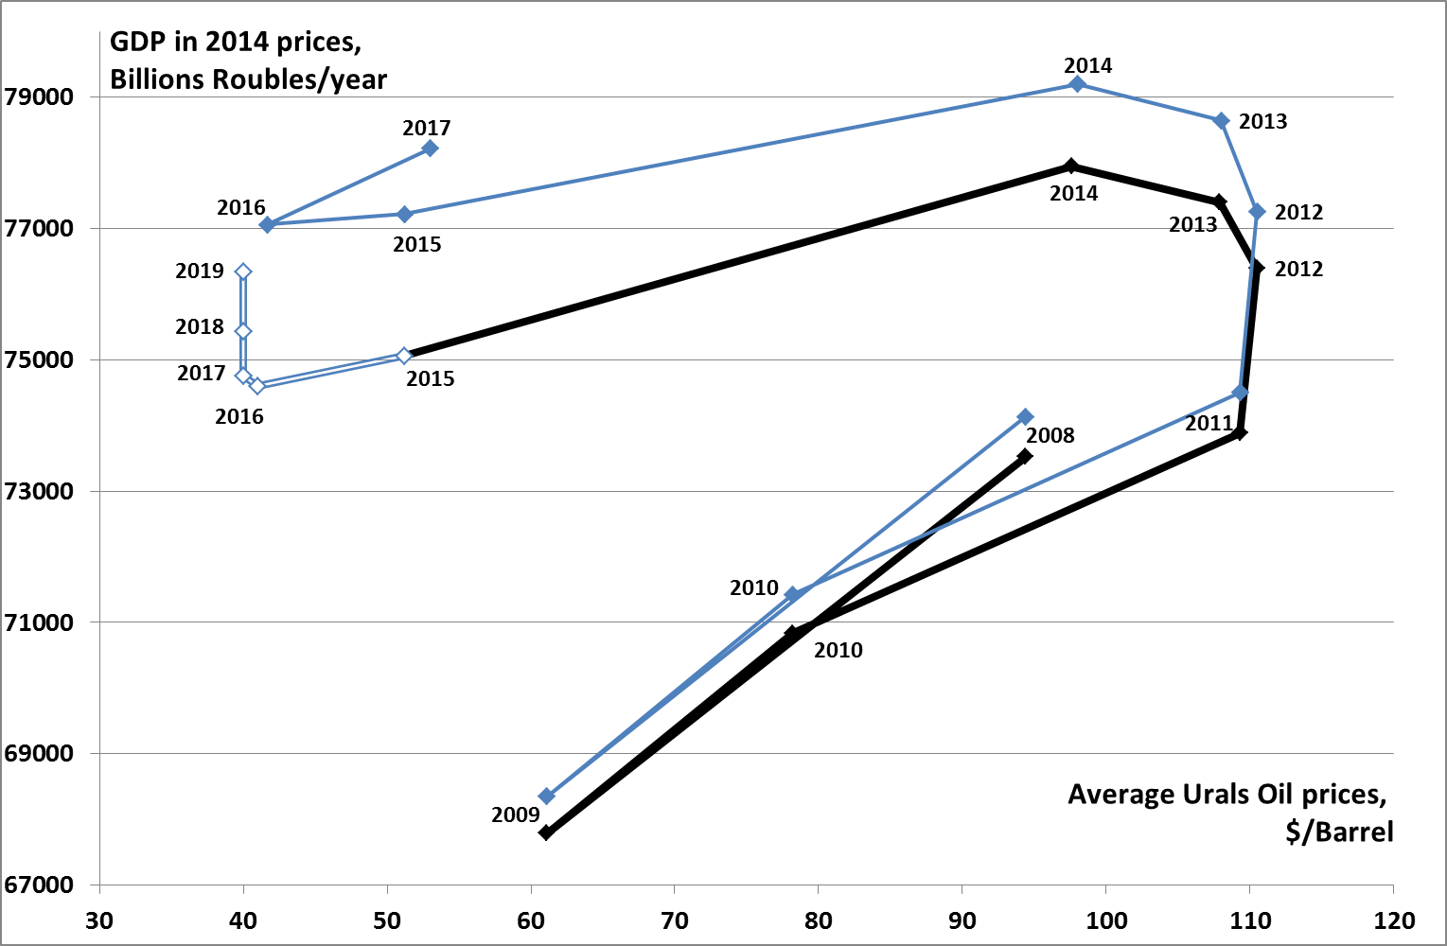
Evaluation of the forecast accuracy
Statistics available in 2018
2016 midterm Forecast
Statistics available in 2016

Slide 20
Evaluation of the forecast accuracy:
sources of the error
1. Forecast error due to inaccuracy of statistics
3. Error due to deficiencies of forecasting tools
2. Forecast error due to incorrect of assumptions

Slide 21
II-1. Reliability of statistics
Ensure that the up to date statistics is used in the forecasting process
Assess the accuracy of the statistics applied
Assess and articulate the magnitude of forecast bias due to inaccuracy of statistics

Slide 22
II-2. Feasibility of assumptions
Identify and articulate the underlying assumptions
Ensure the assumptions coherence with policies activities and programmes to be run during the forecasting period
Ensure that the most probable contingencies are taken into account
Ensure that probability of different scenarios is taken into account

Slide 23
II-3. Adequacy of the forecasting tools
Identify and articulate the methods applied
Ensure the quality of in-sample fitting
Test the methods performance out of sample

Slide 24
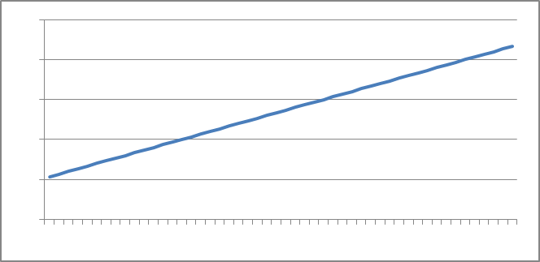
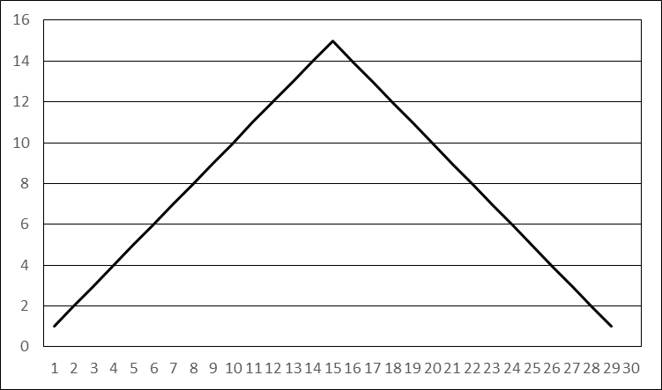
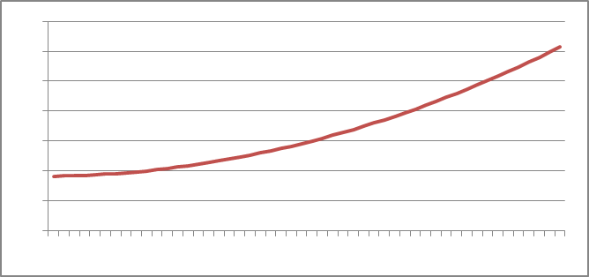
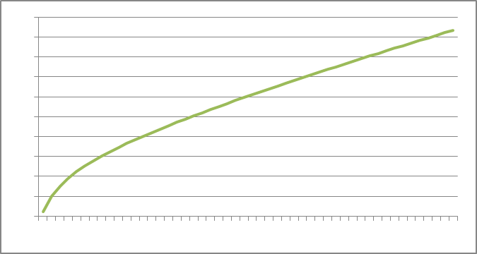
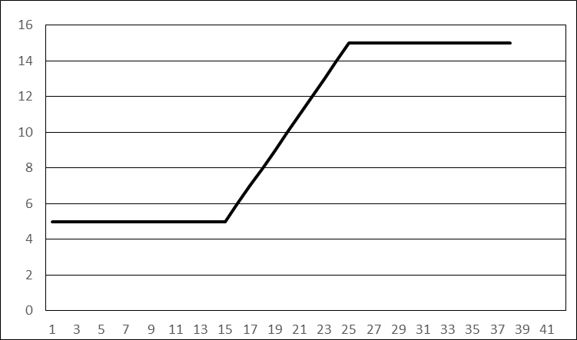
Forecast self-consistency assessment
$$Y+T=$$
$$C+G+I+Inv+$$
$Ex−Im+$Δ

Slide 25
Presentation plan
Project outline
Institutional framework for the Audit of reliability of macroeconomic forecasts
Structuring the subject matter
Concluding remarks

Slide 26
Testing the draft GUID
In order to ensure universal applicability the draft guidance is to be tested by the members of WGKNI with different national settings in relevant audit engagements
Project Proposal
In order to test the Draft Guidance:
Conduct audits
Conduct joint or parallel audits
Conduct other engagements
Analyze applicability of the Draft Guidance to the audits and other engagements already conducted

Slide 27
Project timeline – the proposed additional activities

Slide 28
Audit of reliability of macroeconomic forecasts
THANK YOU!

