Slide 1
UN Sustainable Development goals Implementation of the 2030 Agenda in AUSTRIA Report of the Austrian Court of Audit from 6 July 2018
Meeting of the Workinggroup on Key National Indicators from 2nd to 4th of April 2019 in Bratislava

Slide 2
Aims of the audit 1
Assessment of
the legal framework conditions and the national recognition of the SDGs;
the assignment of responsibilities
on federal level;
the coordination across all levels of government;
the inclusion of civil society.

Slide 3
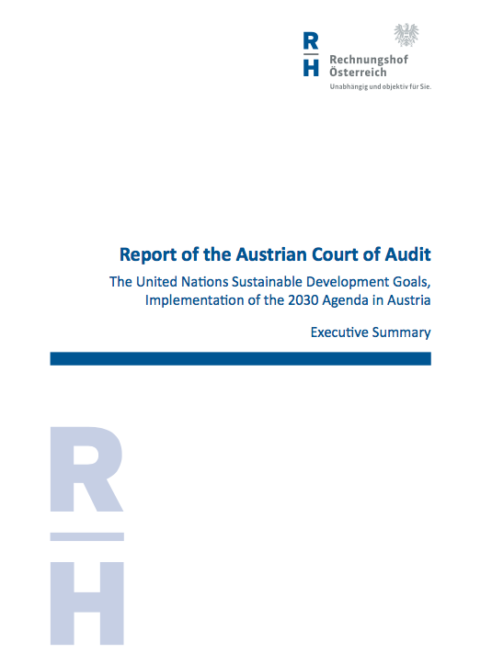
Aims of the audit 2
Furthermore we took a closer look at
the evaluation of the initial situation (in the form of stocktaking and gap analyses);
the target attainment monitoring system;
the reporting system on the implementation of the SDGs.

Slide 4
The audited entities
Groups of Ministries/other entities
Federal Ministries responsable for coordination | Federal Chancellery
 | Federal Ministry of Europe, Integration and Foreign Affairs
Federal Ministries with responsibilities closely linked to the SDGs | Federal Ministry of Sustainability and Tourism
 | Federal Ministry of Transport, Innovation and Technology
Consulted further entities | Statistics Austria, the Austrian statistical office
 | civil society representatives, such as NGO umbrella organizations

Slide 5
Some critical observations
interministerial working group – led by the Federal Chancellery and the Ministry of Foreign Affairs – with a very narrowly designed mandate: it only comprised coordinating the reporting on the implementation
no other organizational entity at the Federal level was tasked with coordinating the implementation of the 2030 Agenda.
despite numerous activities for SDG implementation a systematic coordination across all levels of government lacked, as did structures for the involvement of civil society

Slide 6
Recommendations
to set up the working group as a national steering body
preparation of a sustainability strategy that contains a coherent nationwide mechanism and takes into account the Provinces and municipalities as well as the civil society
Federal Ministries in charge should systematically involve the Provinces and municipalities as well as the civil society in the implementation of the 2030 Agenda

Slide 7
Contributions of the ACA to the SDG-implementation
conducting performance audits on subjects which contain SDG implementation measures
topically assigning individual goals or targets to the departments of the Austrian Court of Audit
Planned audit on a specific SDG target in 2019 – most probably target 12.3 (which calls for halving per capital global food waste and reducing food losses along production and supply chains).

Slide 8
Further information on the SDG-audit
Website of the Austrian Court of Audit
https://intra.rechnungshof.gv.at/en/audit-reports/view/the-united-nations-sustainable-development-goals-implementation-of-the-2030-agenda-in-austria.html
Many thanks for your attention!
Elisabeth Dearing
Expert on Public Governance
Contact: dearing@rechnungshof.gv.at
Mobile: +4367689118814

