Slide 1
Benchmarking Information Exchange project
Supreme Audit Office of the Slovak Republic
Jana Juriová
analytical department, SAO SR
WORKING GROUP ON KEY NATIONAL INDICATORS
rome, march 2018
Notes:
First of all, let me briefly explain the topic „BIEP“ that is a new approach of SAI´s cooperation. The BIEP shows our response to the concerns of our partners and of course to our citizens. To promote good governance is our responsibility and this is also our duty. Before I will describe you what is the BIEP about have look at an example based on results-oriented comparison of empirical data.

Slide 2
Did you know …?
The average office space per government employee in Czech Republic in 2016 was 14 m² compared to the United Kingdom which was just 10 m².
Source:
SAO CR Audit Conclusion No. 16/26
Cabinet Office (UK), The State of Estate report 2015-2016
NAO (UK), Progress on the government estate strategy
Notes:
Before digging deeper into the project Did you know the average office space per state worker in CR in 2016 was much higher compared to the United Kingdom? Study methodologies slightly differ, but as a result it clearly presents effect for improving performance management in this field of government expenditures. Later on I will be a little bit more specific concerning this benchmarking topic.

Slide 3
ISSAI 1 – Lima Declaration
SECTION 15, ARTICLE 1
The international exchange of ideas and experiences within the International Organization of Supreme Audit Institutions, is an effective means of helping Supreme Audit Institutions accomplish their tasks.
Notes:
We find support for this benchmarking activity in ISSAIs!
So, let me say a few words about the international audit standards concerned.
I am sure the all of us know that ISSAIs are encouraging SAIs to cooperate internationally and the BIEP, that I am going to report about, should be the tool that gives encouragement to share ideas and experiences based on agreed methodology for specific fields of examination and comparison.
Lima declaration clearly states the purpose on international cooperation however its form is up to our SAIs.

Slide 4
ISSAI 10 – Mexico Declaration
PRINCIPLE 4
Unrestricted access to information: SAIs should have adequate powers to obtain timely, unfettered, direct, and free access to all the necessary documents and information, for the proper discharge of their statutory responsibilities.
Notes:
Now we will take a closer look at the second level of ISSAI. Let ´s expand our recognition and understanding of this core principle to include cross-border data and information sharing in our daily working routine. For example, the Slovak SAO cannot ask Austrian´s government for data and information directly. The only way to get the data is to ask the Austrian Court of Audit to provide them to us. So, the qualitative change of our approach is based on standardized cooperation procedures on the executive level of management and of course on the level of authorized auditors. Standardized procedures on the operational level are linked to different tasks that also cover methodology issues of data and information collecting and sharing.

Slide 5
EUROSAI Database of audits
http://www.eurosai.org/en/databases/audits/
Notes:
In addition to introducing project BIEP, let me show you an interesting database that the Czech Republic is administering. This is a screenshot of a webpage of a database of audits on the EUROSAI website. The database was launched in 2015 with the aim to gain and collect as many audits as possible that were carried out by the EUROSAI member states and the database is accessible to the auditors of course, but to the public as well. Combining tool BIEP and EUROSAI Database of audits we get a higher level of learning capacity of effectiveness and optimization.
At the moment, there are 28 EUROSAI member states and the European Court of Auditors contributing to the database. So over half of EUROSAI members add various materials concerned with their audits. Most recent new contributor is Iceland and Ireland. At the moment there are more than 1500 audit reports in the database.

Slide 6
Types of cooperative audits
PARALLEL AUDIT
Separate audit reports
Separate audit teams
JOINT AUDIT
1 audit report
1 audit team
COORDINATED AUDIT
Joint audit with separate audit reports
Parallel audit with single audit report, in addition to separate national reports
Useful for unlimited audit reports
No need for special audit team
Notes:
For better understanding on this slide I present three forms of cooperative audits which are clarified in the ISSAI 5800.
The BIEP brings a different approach, actually a completely new approach, because it offers the most flexible way of cooperation between SAIs. The BIEP is a tool that gives encouragement to share ideas and experiences based on same methodology for specific field. A methodology should be developed and verified by a SAI. This type of cooperation between SAIs can save time and audit costs and is very efficient from the view of administrative procedures compared to classic forms of cooperative audits.

Slide 7
What is BIEP about?
The new LIGHT COORDINATED AUDIT APPROACH that is not limited to SAIs of V4+2
The innovative data and information exchange based on the principles of 3C: communication, cooperation, comparison
Enhanced use of data and development of common methodologies for comparison within the trans-boundary topics but not only
The tool that can identify an area of best practice in public administration
Provides new level of information for SAI’s audit reports
Notes:
So what is BIEP about?
We could call this project a new light coordinated audit approach. CR introduced the BIEP at the V4+2 meeting in Lednice in September 2016. The data and information exchange is based on the principles of 3C – communication, cooperation and comparison. These principles were introduced at the EUROSAI Congress in Instanbul last year and we are keen to apply them consistently and we encourage other SAIs to do same here.
Within BIEP we generally use different benchmarking methods which allow to compare the practice in different countries. Comparable indicators can be for example the cost of highways contruction work per kilometre, daily hospital costs per patient, cost for putting unemployed person to work and so on – it can be anything. Last but not least the BIEP can also identify a good practice so our approach is not limited only data or result—oriented benchmarking. We do a lot to proceed in the direction of linking results-oriented data to processes-oriented and strategic-oriented benchmarking in analytical way.

Slide 8
BIEP principles of cooperation
SAI can suggest a new topic for benchmarking or SAI can choose any specified topic
SAI can start cooperation at any stage
SAI can use already existing methodology or create a new one
SAI can use the BIEP methodology and results for its own country report
SAI should share results and other documents on the EXTRANET

Slide 9
EXTRANET for easy information exchange
https://projekty.nku.cz/BIEPwr3e52xih8yp

Slide 10
Unlimited areas of comparison
Utilization of real estate
Social housing
Road infrastructure
Centralized purchasing system
Animal and plant production
Other …

Slide 11
Area of comparison: Government Real Estate
Sub-area: Management of utilisation of buildings by government departments and agencies
Audit of SAO CR in 2017
Data collection not limited to V4+2
Draft benchmarking methodology designed and shared
KPIs identified and set
Benchmark value for the KPIs learnt
Notes:
Now I will present the audit report of SAO CR on the operation and the use of immovable property.
Last year they finished the audit no. 16/26 in which we examined expenditures on operations and use of real estate and IT support regarding to its effectiveness and efficiency.
As data source they used central register of administrative buildings. Every government entity in CR has to submit there the details of property which they use or own (such as building age, energy efficiency) and consumptions and expenditures relating to that property.
They compared data and information on strategic level (it means a comparison of real estate management systems) and on operational level (where they compared available key performance indicators). Results of international comparison are available in the annex of audit report that you can find on official web site of SAO SR and of course in the EUROSAI Database of audits.
The process of the cooperation was easy.

Slide 12
Expenditure on the operation and the use of immovable property
Data source – Central register of administrative buildings
Results of international comparison
Benchmarking strategic level
Benchmarking operational level
Process of cooperation
Desk Research
Questionnaire to SAIs
Communication with SAIs to specify the information
Notes:
They started with desk research. After that they had prepared a document that covered background and setting of the real estate management system in the Czech Republic. Consequently, to get more comparative date they conducted survey among other SAIs, also Slovakia. Addressed SAIs provided the facts of real estate management in their countries and possibility of calculation of selected indicators. Then were discussed some points and to confirm and interpret the data properly and to identify reference effectiveness and efficiency.
On the strategic level there were recognised various attitudes to real estate management. A table was prepared that describes real estate management systems in Czech Republic, Slovak Republic, Hungary and United Kingdom. You can simply compare property management systems and how they function and information systems used in this field such as existence of real estate strategy, central register, using KPI, etc.

Slide 13
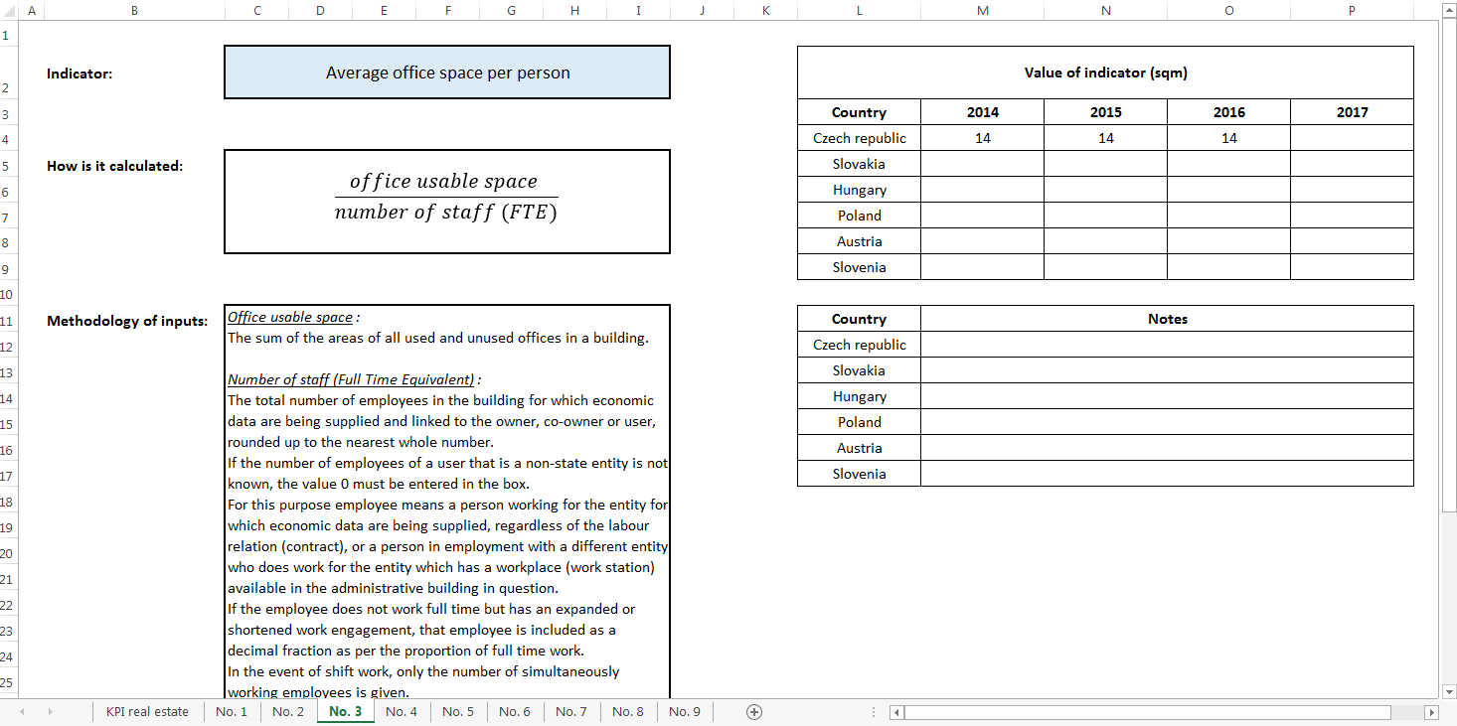
Key Performance Indicators
Notes:
Finally, SAO CR also prepared a table of indicators relating to utilization of real estate. As you can see, in every indicator there is the methodology and values which were calculated for CR. SAI can calculate a value of the indicator using the formula and fill in the value for their country. If there are any limitations, SAI can fill them in as notes.

Slide 14
Area of comparison: Animal and Plant Production
Structure of direct payments (sets of indicators from EU, %) + national sets of indicators – which is the best practice for indicators and open question about different other forms of support
The amount of contributions from state budget for particular countries (value added)
The amount of subsidy per 1 animal on average
Notes:
The proposal for international comparison between SAO SR and SAO CR.

Slide 15
Area of comparison: Building-up, reconstruction and maintenance of roads
Sub-area: Expenditures on bridges construction works and their maintenance –proposal of SAO SR
DESK REVIEW (SAO SR) – bridges on the roads of 2nd and 3rd class
AUDIT (SAO CR) – mainly roads of 2nd and 3rd class, but included 5 projects for bridges
Benchmarking cover performance KPI (costs) and processes
Information and data collection reduced on Czechia and Slovakia
Benchmarking methodology still in progress
KPIs: sources of financing, state of the roads in 2016 and processes are benchmarked

Slide 16
FUTURE COOPERATION AND CHALLENGES
Platform for sharing databases and exchange of data
Shared methodology is key success factor
Need for more coordination and information
SAI CR prepares new web page of BIEP
Extranet is expected to contain database with KPI in different fields of comparison
Annual audit plan exchange?
Medium-term audit prospects exchange?
Estonia, Poland – expected communication of SAO CR, effort to join BIEP
Notes:
Let me summarize briefly the main points.
Firstly, the most important thing in the international comparison is the methodology. The methodology must be specified. You can use already existed methodology or suggest a new methodology.
We usually find out that inputs and surroundings in different countries are not same. If the inputs are not very different, we can compare the results but we should underline the differencies.
Secondly, Benchmarking Information Exchange Project can bring you a monitoring of systems and indicators or a detection of new audit field.
Thirdly, results can be used by anyone. The more countries participate in Benchmarking Information Exchange Project, the better you will use the results for international comparison.

Slide 17
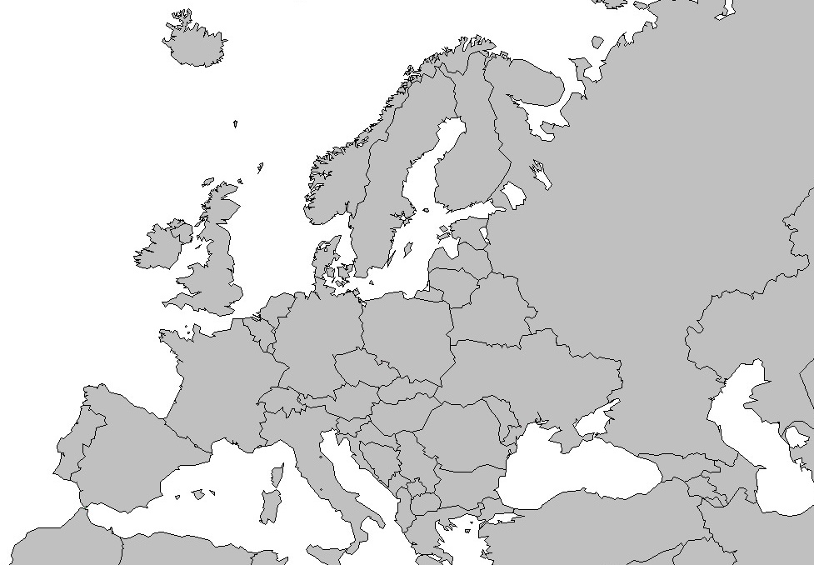
Let‘s BIEP
Notes:
On behalf of SAO CR I would like to invite you to participate in the project. Let’s BIEP!

Slide 18
Thanks for your attention.
Jana Juriová|jana.juriova@nku.gov.sk

