Slide 1
Risk analysis at SAI Slovakia (used in strategic planning) Jana Juriová
Supreme Audit Office of the Slovak Republic
WORKING GROUP ON KEY NATIONAL INDICATORS
Analytical department
Supreme Audit Office of the Slovak Republic
Rome, March 2018

Slide 2
First step
Mid-term strategy of SAO SR Strategic areas of audit activities of SAO SR for period 2018 – 2020 (analytical department, 2017), strategic areas were identified according to their significance:
According to frequency in strategic goals of SR (especially national reform programme)
Aspect of identified national problems (international institutions)
Risks in the area

Slide 3
Criteria for defining significance of strategic areas
Strategic areas
1. Global, European and national goals
2. National problems based on recommendations from national and international institutions
3. Risks according to standards
Notes:
The strategic audit plan and the audit priorities for the period of 2018 to 2020 are based on analysis of:
Global, European and National Goals
National topics based on recommendations from national and international institutions
Risks according to standards

Slide 4
STRATEGIC AREAS
1. Education, research and innovations
2. Effective and transparent public administration
3. Health
4. Employment and business environment
5. Sustainable consumption and production, energy efficiency and environmental sustainability
6. Sustainable public finances and fiscal policy
7. Social policies
8. Transport Infrastructure and ICT
9. Defense and security 10. European and structural investment funds
Notes:
9 areas of public policies + eurofonds as an important tool of financing policies

Slide 5
1. SIGNIFICANCE OF THE AREA
1. Global, European and national goals: Agenda OSN 2030, Strategy Europe 2020, Government declaration SR 2016 - 2020, National Reform Programme 2016 a 2017 (tasks from action plans)
2. National problems based on recommendation of domestic and international institutions: Recommendations of EU Council for SR 2016 and 2017, Country report from EC 2016, 2017 and 2018, Publication of OECD „Going for Growth“ 2017
3. Risks according to international standards ISSAI (100, 200, 300, 400):
areas traditionally prone to risks are information systems, health, public procurement and environmental issues

Slide 6
METHODOLOGY FOR DEFINIG PRIORITY AREAS FOR 2019
1. Significance of area
2. The amount of financial expenditures for policy in particular areas
(% of GDP, yearly average for period 2012 – 2017)
3. International comparison based on indicators, we can determine the most lagging areas of SR behind EU average

Slide 7
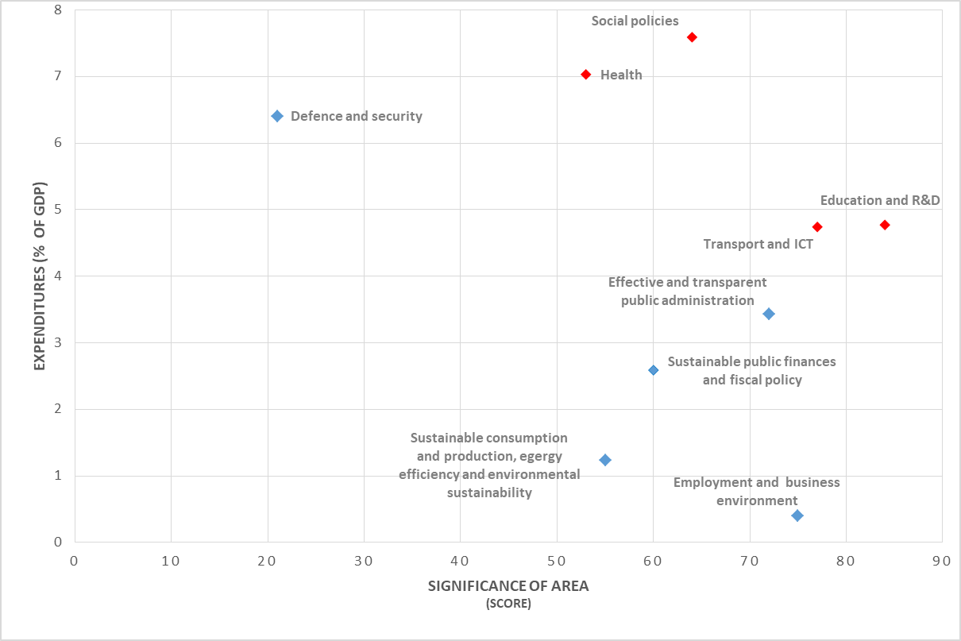
Significance vs. expenditures of SR for strategic areas

Slide 8
International comparison for strategic areas
Strategic area | Indicator | Year | SR | EU28 | Share of SR at EU28 average (%)
Education | Rate of finished tertiary education in EU countries (% of population at the age of 30 - 34 years) | 2016 | 31,50 | 39,10 | 80,6 %
R&D | Expenditures on R&D (% GDP) | 2016 | 0,79 | 2,03 | 38,9 %
Education and R&D | Average |  |  |  | 59,7 %
Transport | Density of highways per 1000 km² | 2016 | 9,00 | 22,30 | 40,4 %
ICT | DESI - Index of digital economy | 2017 | 0,46 | 0,52 | 88,5%
Transport and ICT | Average |  |  |  | 64,4 %
Effective and transparent public administration | Perception corruption Index (score) | 2017 | 50,00 | 65,34 | 76,5 %
Energy efficiency | Share of energy from renewable sources on total gross energy consumption (%) | 2016 | 12,00 | 17,00 | 70,6 %
Environmental sustainability | Exposure of the urban population to ozone-depleted air (μg/m3 per day) | 2014 | 5 020 | 3 243 | 64,6 %
Agricultural policy | Gross nutrient balance per hectare (kg/hectare) – nitrogen | 2013 | 49,00 | 51,00 | 96,1 %
Sustainable consumption and production, energy efficiency and environmental sustainability | Average |  |  |  | 77,1 %
Defence and security | Expenditures on defense (% GDP) | 2015 | 1,10 | 1,40 | 78,6 %
Health | Years of health life at birth | 2015 | 54,95 | 62,95 | 87,3 %
Employment and business environment | Employment rate 20-64 years (% of population) | 2016 | 69,80 | 71,10 | 98,2 %
Social policies | Population endangered by poverty and social exclusion (% of population) | 2016 | 18,10 | 23,50 | 129,8 %*
Sustainable public finances and fiscal policy | Gross public debt (% GDP) | 2016 | 51,80 | 83,20 | 160,6 %*

Slide 9
Priority areas for 2019
Based on the combination of significance and expenditures:
Transport infrastructure and ICT
Health
Education, research and innovations
Social policies
Based on the international comparison (lagging of SR):
Education, research and innovations
Transport infrastructure and ICT
Effective and transparent administration
Sustainable consumption and production, energy efficiency and environmental sustainability
Specific priority area – European funds

Slide 10
Thanks for your attention.
Jana Juriová|jana.juriova@nku.gov.sk

