Slide 1
XXIII INCOSAI
Theme II «THE ROLE OF SAIs IN THE ACHIEVEMENT
OF THE NATIONAL PRIORITIES AND GOALS»
Dmitry Zaytsev
Accounts Chamber of the Russian Federation
Bratislava, Slovakia April 2-4, 2019

Slide 2
XXIII INCOSAI
XXIII INCOSAI – Moscow, September 23-29, 2019
Theme I
Information technologies for the development of the public administration
(Chaired by SAI of China)
Theme II
The role of the Supreme Audit Institutions in the achievement of the national priorities and goals
(Chaired by SAI of Russia)

Slide 3
THE EXPERT GROUP ON THEME II
Since 2018, February
Coordinator: SAI of Russia
Participants: 22 SAI – Armenia, Austria, Azerbaijan, Belarus, Brazil, Cuba, Hungary, India, Indonesia, Italy, Kazakhstan, Mexico, Poland, Portugal, Saudi Arabia, Slovakia, Slovenia, South Africa, Spain, Turkey, UAE, USA and INTOSAI Development Initiative (IDI), GIZ

Slide 4
NEW CHALLENGES FOR PUBLIC AUDIT APPROACHES
New approaches
Proactive approach
Whole-of-government approach + evaluation of policy coherence
Strategic planning, effective allocation of SAI resources
New quality of communication with stakeholders
Changes in environment
2030 Agenda for Sustainable Development
Growing public demand for transparency of national governments
Data revolution
Development of pronouncements under IFPP
New competences/skills
Evolving roles of SAI
Role of advisor
Role of researcher
INCREASE OF SAI VALUE FOR CITIZENS
New tools

Slide 5
STRATEGIC AND INTEGRATED APPROACH TO AUDITING
«Subject matter «
49 SAI answers
Аpproach / specific toolkits
14 SAI answers
Research and advisory function 14 SAI answers
Wide-scope strategic planning (24 references)
Core nation-wide issues producing long-term effects (national goals and priorities, SDGs) (19 references)
High-level decision making (8 references)
All stages of policy cycle (5 references)
Cross-sectoral analysis (15 references)
Integrated approach (5 references)
Whole-of-government approach (4 references)
Set of compliance, financial and performance audits implemented in coordinated manner (4 references)
Greater stakeholder engagement, new communication strategies (2 references)
Best practices sharing (1 reference)
Forward-looking approach (10 references)
Result-oriented recommendations (10 references)
Assessment of feasibility, risk analysis (7 references)
Foresights, impact assessment (5 references)
Advanced research and analytics (3 references)
57 SAI supported / complimented the concept of the Theme II Principal paper 1 SAI proposed to change the term “strategic audit”
1 SAI opposed the adoption of the term “strategic audit” in INTOSAI documents

Slide 6
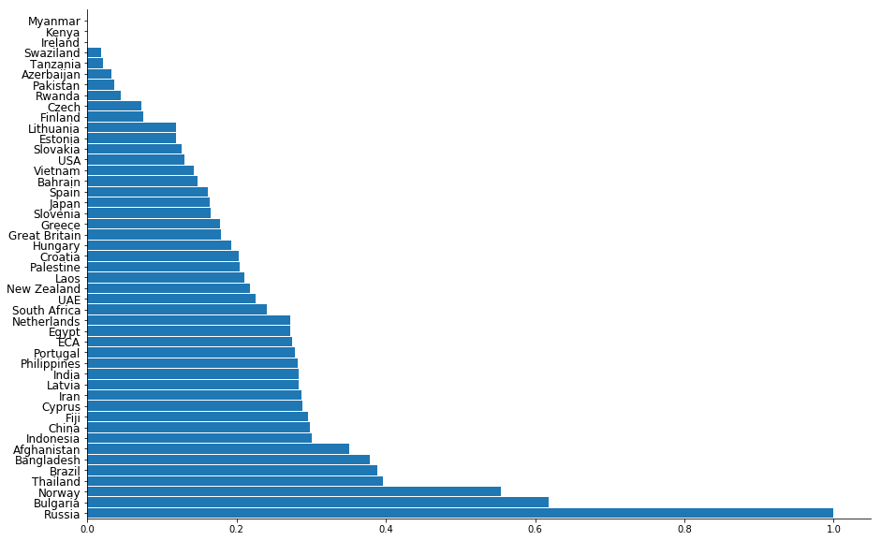
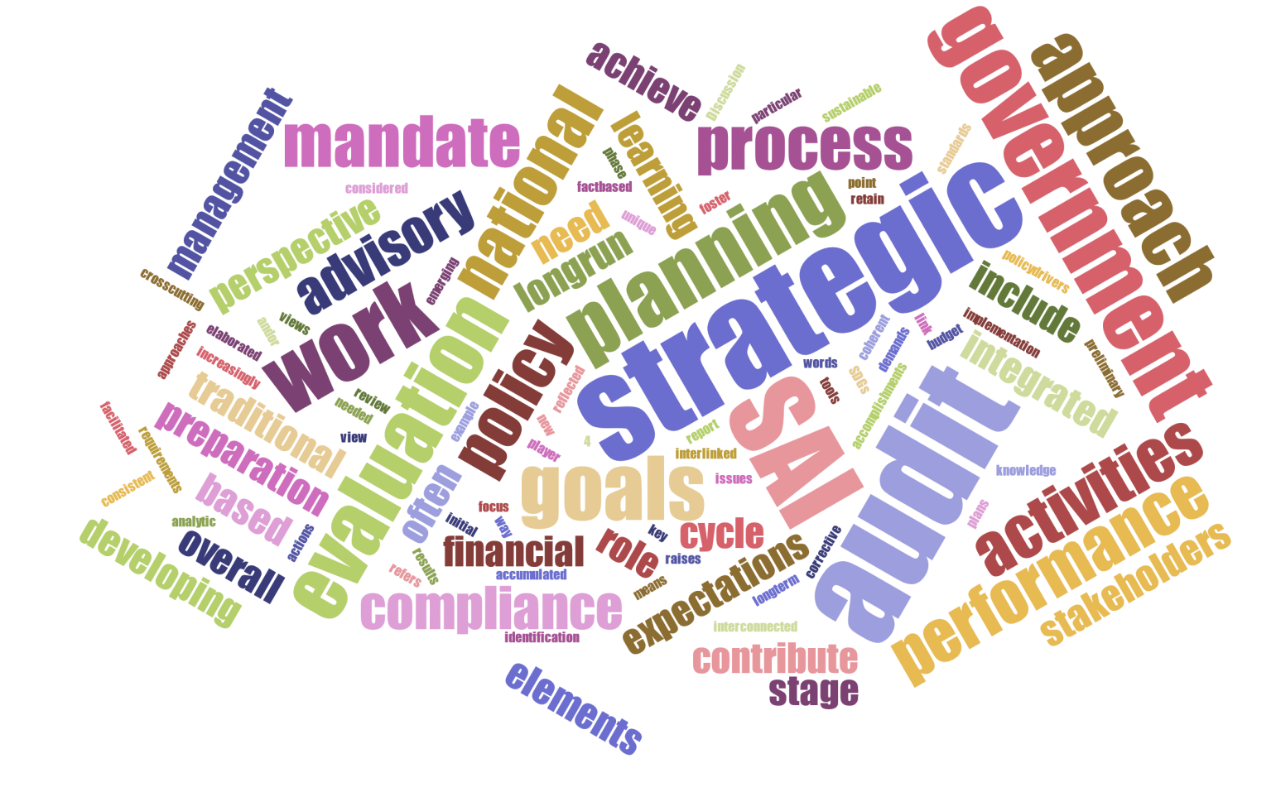
WORDING MATCHING IN DEFINITIONS OF STRATEGIC AUDIT APPROACHES

Slide 7
SAI ROLES BEYOND TRADITIONAL FUNCTIONS
A – recommendations entirely based on audit work
В – extensive recommendations/consultations beyond audit work
С – research aiming to develop methodological toolkit or good practice guides
D – research aiming to determine key trends/risks

Slide 8
DEVELOPMENT OF KEY SKILLS

Slide 9
BENEFITS OF ADVISORY FUNCTION
1. Autonomy relevance dilemma
NUDGE GOVERNMENTS BY AUDITING AND ADVISORY ACTIVITIES
2. Advisory activities:
Lima declaration - To provide parliament and the administration with their professional knowledge in the form of expert opinions under the condition that the effectiveness of their audit is secured
3. Advisory activities should be within SAI’s mandate and not violate SAI’s auditing function

Slide 10
CHALLENGES AND EXPECTATIONS FROM THEME II DISCUSSION
AT THE XXIII INCOSAI
Key topics of the Discussion paper on the Theme II
SAIs expectations from the Congress
Institutional issues
Lack or weakness of related mandates (11 references)
Recommendations in constantly changing environment (10 references)
“Relevance vs. Independence” dilemma (5 references)
Organizational issues
Focusing on key audit topics (14 references)
Lack of an effective communication between the SAIs and their stakeholders (14 references)
Resources and Tools
Limited resources (highly skilled staff) (30 references)
Lack of methodology and toolkits (14 references)
Poor access/quality of data (8 references)
Consideration of problems related to strategic audit and their possible solutions (30 references)
Best practice sharing (5 references)
Development of a common understanding of strategic audit (13 references)
Discussion of the role of strategic audit for SDG auditing implementation (6 references)

Slide 11
THANK YOU!

