Slide 1
Working group on Key National Indicators:
New Directions
Dmitry Zaytsev
Accounts Chamber of the Russian Federation
Bratislava, Slovakia April 2-4, 2019

Slide 2
WGKNI: MAIN ACHIEVEMENTS
White Paper on KNI
Guidelines for the use of key national indicators in performance audit
Methodology on the Key National Indicators selection for the use in SAIs’ activities
Guidance of audit of the use and development of KNI
Guidance on audit of reliability of macroeconomic forecasts

Slide 3
CHALLENGES AND EXPECTATIONS FROM THEME II DISCUSSION
AT THE XXIII INCOSAI
Key topics of the Discussion paper on the Theme II
SAIs expectations from the Congress
Institutional issues
Lack or weakness of SAIs’ mandates (11 references)
Constantly changing environment (10 references)
“Relevance vs. Independence” dilemma (5 references)
Organizational issues
Identifying and focusing resources on auditing priorities (14 references)
Lack of effective communication between SAIs and stakeholders (14 references)
Resources and Tools
Limited resources (staff with advanced and crosscutting analytical capacities, IT instruments) (30 references)
Lack of methodology and toolkits (14 references)
Poor access/quality of data (8 references)
Consideration of problems and solutions related to strategic and integrated audit (30 references)
Development of a common understanding of strategic audit and possible methodology (13 references)
Discussion of the role of strategic audit for auditing SDG achievement (6 references)
Best practice sharing (5 references)

Slide 4
SOCIETY’S EXPECTATIONS FROM SAIS’ ACTIVITIES
Implementation of long-term national development programs
Increased demand for measuring and enhancing public sector performance
Development of new tools (high-quality research and recommendations) = new methodology and guidelines

Slide 5
EXECUTIVE ORDER ON NATIONAL GOALS AND STRATEGIC OBJECTIVES OF THE RUSSIAN FEDERATION THROUGH TO 2024
National dimension of SDG achievement
Main strategic document signed by the President of the Russian Federation on 7 May, 2018
Provides specific priorities and targets for Government’s activities
Includes 9 long-term national goals and 12 national projects

Slide 6
ROLE OF THE ACCOUNTS CHAMBER
Strategic partner of the Government that monitors and controls national goals achievement
Identifying systematic governance issues
In-detail preparation of expert and auditing activities, including comprehensive research on a wide range of auditee’s activities
Example: We studied indicators of national projects implementation and found: more than 50% of performance indicators were out of scope of official statistics. We took the leading role in monitoring and work with the Government on improving indicators methodology.

Slide 7
APPROACH OF THE ACCOUNTS CHAMBER
Independent and active engagement
Focus on cooperation for a better policy coherence (“Center of Government”)
Proactivity vs retrospective measures
Focus on analytics, risk management, feasibility evaluation and high quality recommendations
Strategic audit

Slide 8
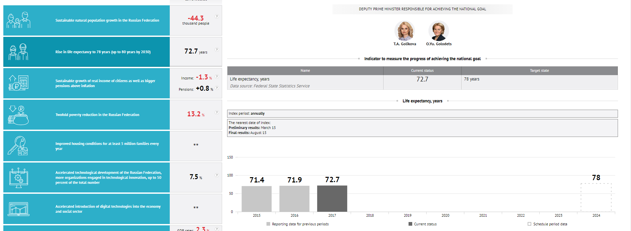
MONITORING EXPERIENCE

Slide 9
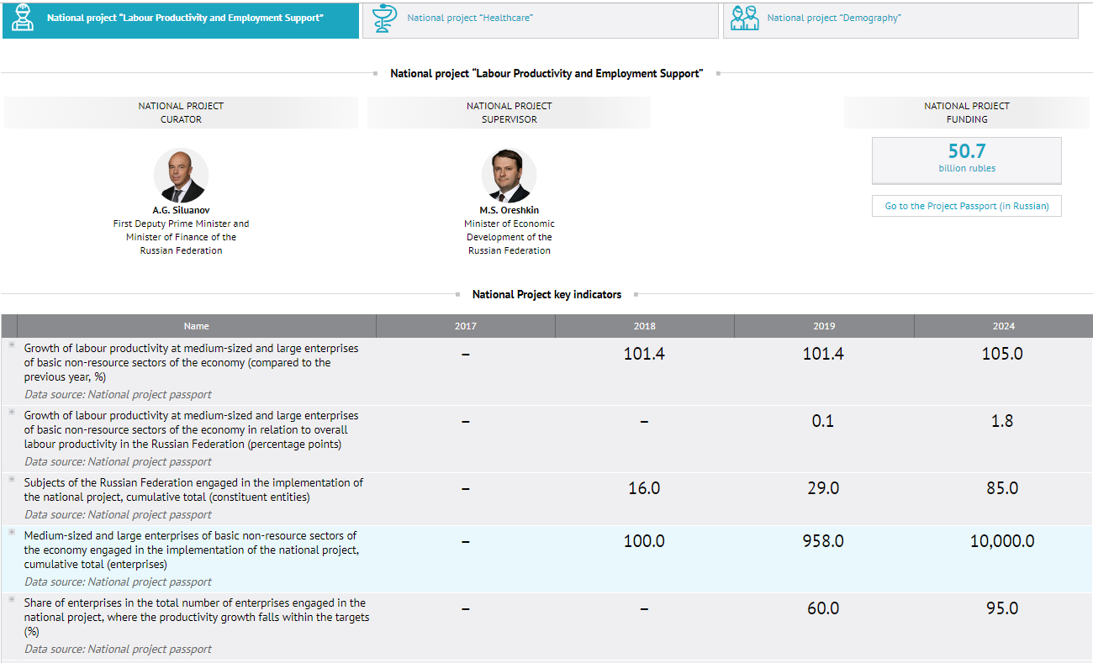
MONITORING EXPERIENCE

Slide 10
RESEARCH ON SAI ROLES BEYOND TRADITIONAL FUNCTIONS
A – recommendations entirely based on audit work
В – extensive recommendations/consultations beyond audit work
С – research aiming to develop methodological toolkit or good practice guides
D – research aiming to determine key trends/risks

Slide 11
COUNSELING: PROS AND CONS
Advantages
Risks
Deepen the findings and impact of audit work
Help improve the public administration performance
Produce valuable knowledge about the government and reducing information gaps
Direct benefits for the society
Losing independence
Solution: avoid involvement in daily business and criticizing political goals
Exceeding mandate
Solution: avoid interference in decision-making processes of auditees
N.B.: Consultants offer knowledge and recommendations as long as they are allowed to

Slide 12
WGKNI: FUTURE DIRECTIONS
Contributing to SAIs’ value increase through developing research and advisory functions
Common understanding of roles & functions
Examination of possible issues & solutions
Methodology & guidelines
Developing information exchange platform
Case studies & best practices
Capacity building programs
Technological innovation

Slide 13
THANK YOU!

